Slide 1
Political Parties
Evolution of the Two Party System
MT. 4 – Learning Target 1
What are political parties and what are they for?
Where did parties come from and how have they changed over time?
What are the political parties today and how are they different?

Slide 2
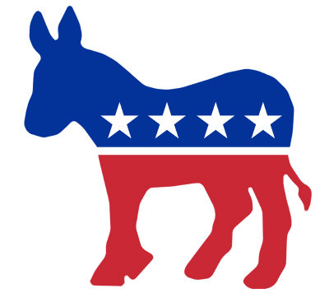
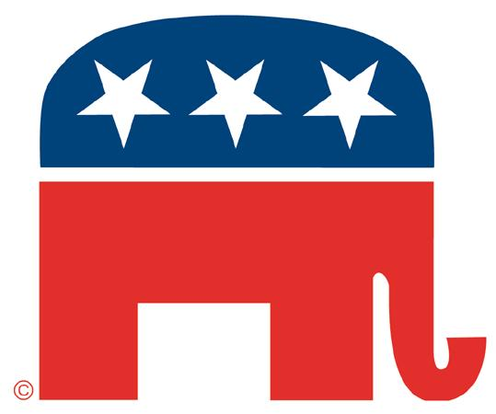
Political Party
A group of people
Influence policy agendas
Hold government power
Elect candidates to public office
Not mentioned anywhere in the Constitution

Slide 3
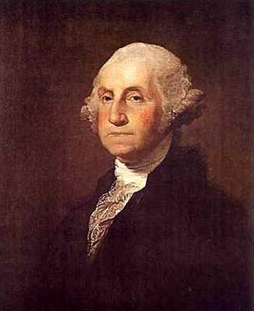
Origins
Originated in Washington’s first term
Most founders were opposed to political parties
Development of “factions” around two powerful figures
George Washington, 1789 – 1797

Slide 4
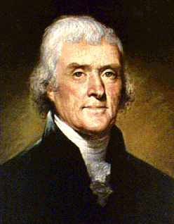
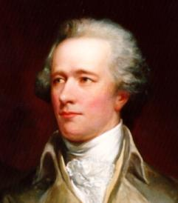
Jefferson vs. Hamilton
Democratic-Republican Party
Federalist Party

Slide 5
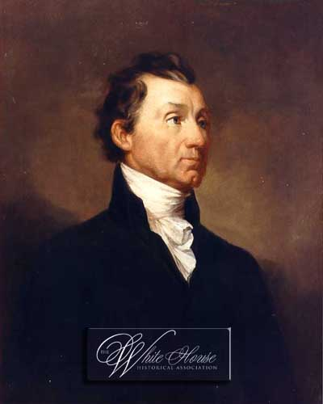
“Era of Good Feeling”: 1816 - 1828
Democratic-Republicans dominated politics
No political party competition
Ended with elections of 1824-1828
James Monroe, 1817 – 1825

Slide 6
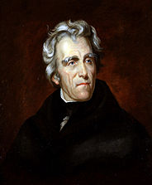
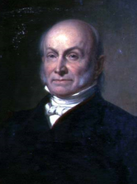
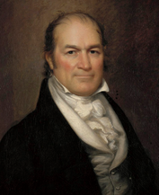
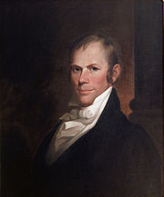
99 Electoral Votes 41.4 % of popular vote
7
84 Electoral Votes 30.9 % of popular vote
13
41 Electoral Votes 11.2 % of popular vote
4
37 Electoral Votes 13.0 % of popular vote
Speaker of the House
Gave his support to Adams
Became Secretary of State
131 needed to be elected

Slide 7
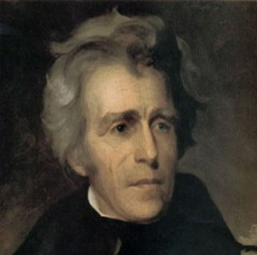
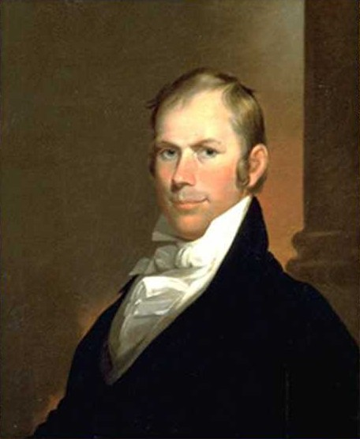
“Jacksonian” Democrats
Whig Party
Jackson became leader of a new Democratic Party
Became party of the “common man” and States’ Rights
Opponents of Jackson supported by merchants, bankers, & planters
Defended federal authority
Andrew Jackson
Henry Clay

Slide 8
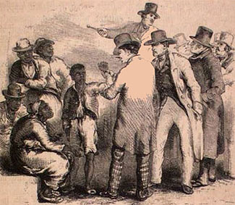
Slavery and the Civil War
Both Whigs and Democrats split over slavery
New anti-slavery party emerged: The Republican Party

Slide 9
The Modern Political Party Era: 1860 - Present
Democratic Party
Republican Party
More liberal party – women, minorities, working class
More conservative party – white males, Christians, middle and upper class voters
Power has shifted back and forth between the two parties in response to national events and priorities

Slide 10
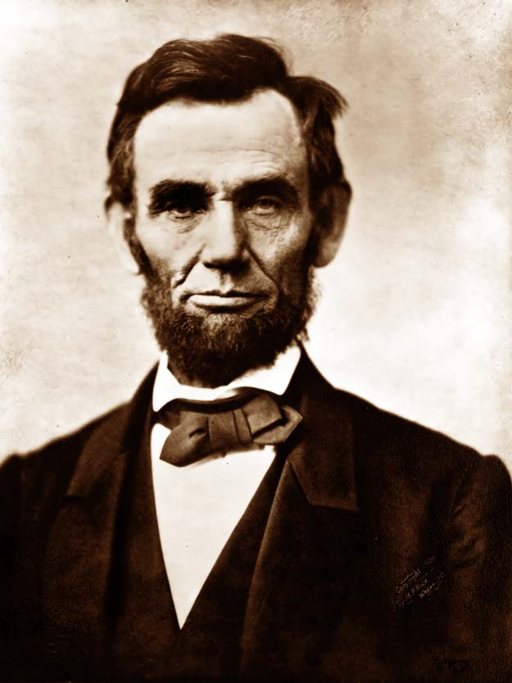
Abraham
Lincoln, 1861-1865
Republicans dominated after the Civil War: 1860 – 1932

Slide 11
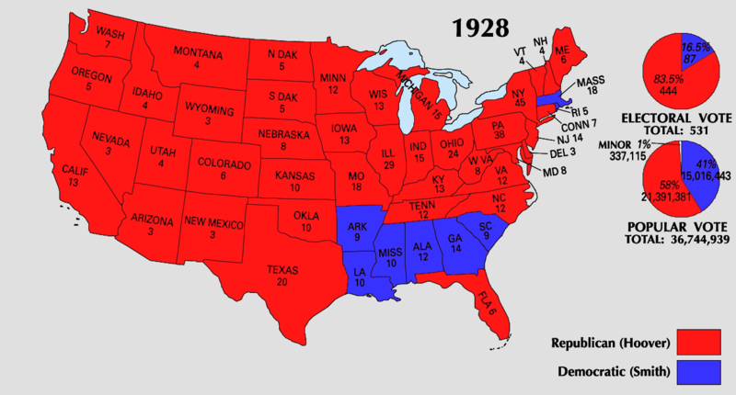

Slide 12
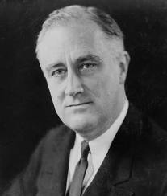
Franklin D. Roosevelt,
1933-1945
Democrats dominated after the Great Depression: 1932-1968

Slide 13
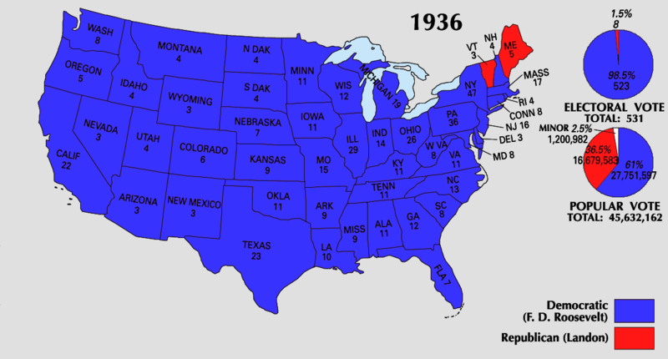

Slide 14
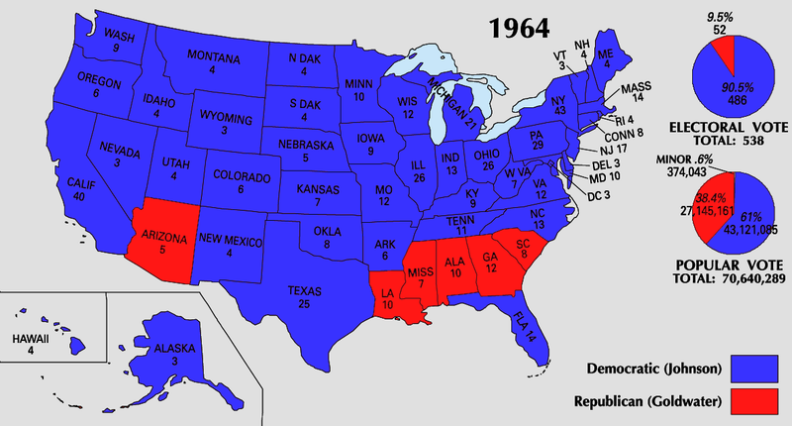

Slide 15
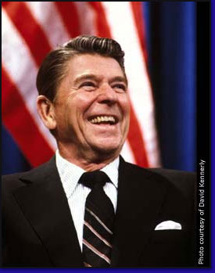
Ronald Reagan,
1981 – 1989
Vietnam War, Civil Rights, & “Reagan Revolution” brought back the popularity of the Republican Party: 1968-1992

Slide 16
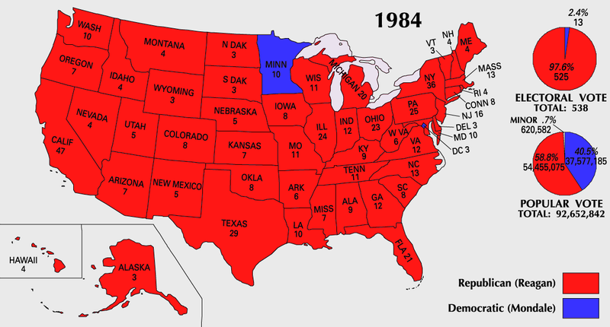

Slide 17
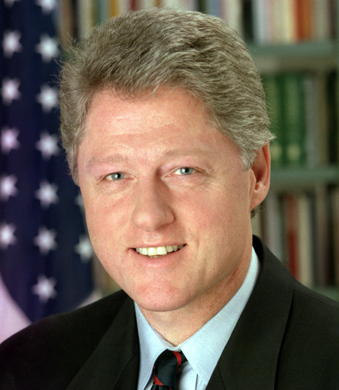
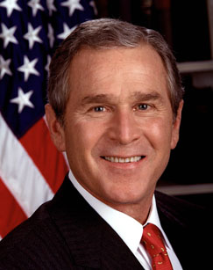
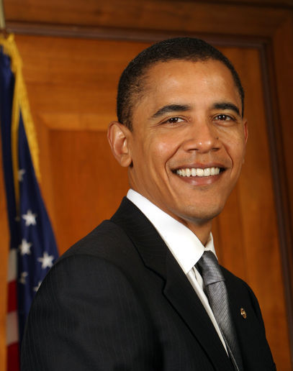
1993 – 2001
Democrat
2001 – 2009
Republican
2009 – 2017
Democrat
No one party has dominated since 1992 election
Split between “Red” and “Blue” states

Slide 18
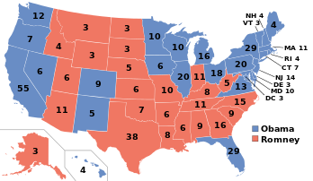
Candidate Electoral Popular
Obama 332 51.1%
Romney 206 47.2%

Slide 19
Third Parties in American Politics
Their Roles and Functions

Slide 20
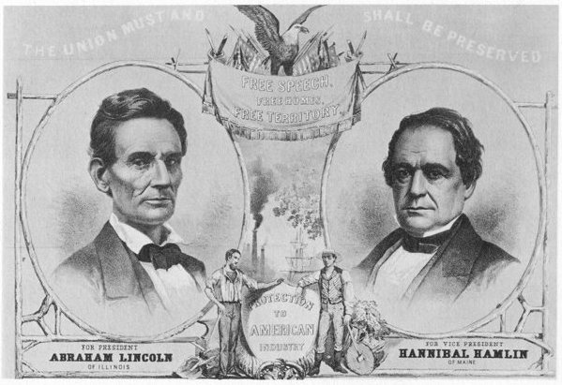
Republican Party, 1856
Green Party, 2000

Slide 21
Types of Third Party
Single Issue Party – formed to oppose or promote one issue
Green Party (2000 - present) – promoted environmental issues

Slide 22
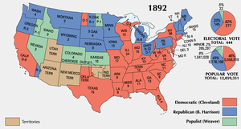
Populist Party, late 1800s
Greenback Party, late 1800s

Slide 23
Types of Third Party
Economic Protest Party – protesting a specific economic problem
Tea Party(2009 - ) – protested increased taxes and government spending

Slide 24
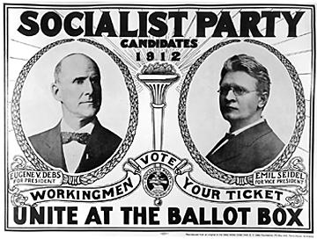
Socialist Party, early 20th Century
Libertarian Party, 1971

Slide 25
Types of Third Party
Ideological Party – formed by people committed to a set of beliefs
Libertarian Party (1971 - present) – favors reducing the role of government in citizens’ lives

Slide 26
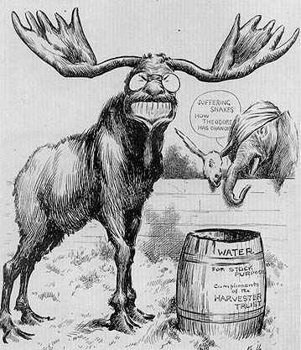
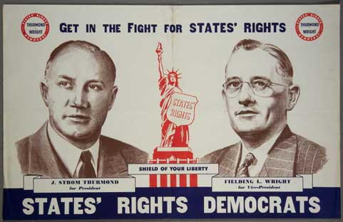
“Bull Moose” Progressive Party, 1912 (split from Republican Party)
States’ Rights Democrats, “Dixiecrats”, 1948 (split from Democratic Party)

Slide 27
Types of Third Party
Splinter Party – formed by people unhappy with a major party
Progressive “Bull Moose” Party (1912)
States’ Rights “Dixiecrat” Party (1948)

Slide 28
Roles Played by Third Parties
Bring new platform issues to the attention of voters
Force major parties to accept specific issues and include them in their platforms
- Green Party = environmental issues

Slide 29
Election Results
US Model: “Winner Take All”
European Model: Proportional Representation
Party | Percentage
Democratic | 40 %
Republican | 35 %
Green | 15 %
Libertarian | 10 %
Party | Percentage
Conservative | 40 %
Liberal | 35 %
Labor | 15 %
Socialist | 10 %

Slide 30
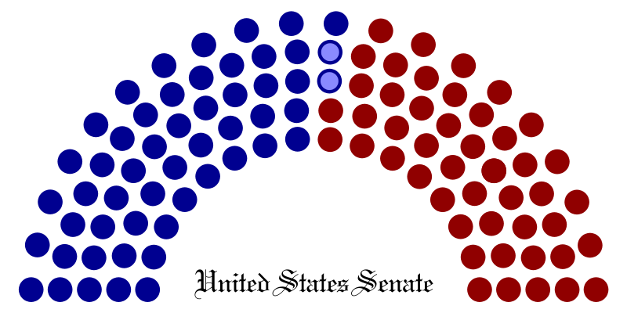
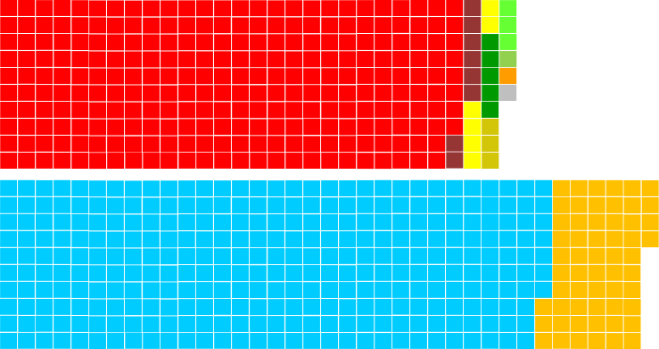
U.S. Two-Party System
(Vote for Candidate)
European Multi-Party Proportional Representation
(Vote for Party)
British House of Commons

Slide 31
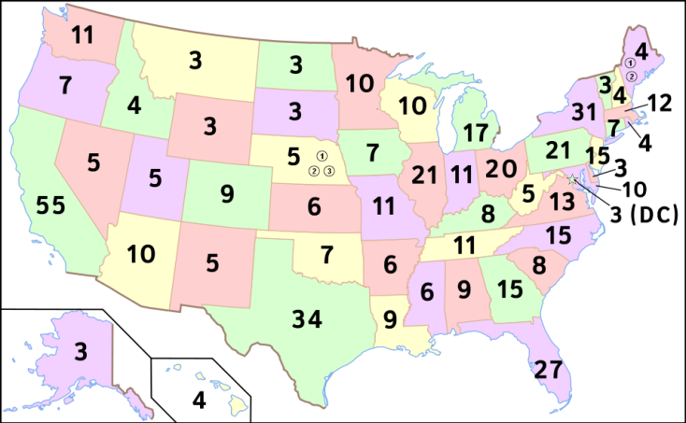
Electoral College and Third Parties
“Winner Take All” System
Whichever candidate wins the most popular votes in any state, also takes all of the electoral votes
Even if a third party candidate receives a large number of votes, if it is not the most votes, that candidate receives nothing

Slide 32
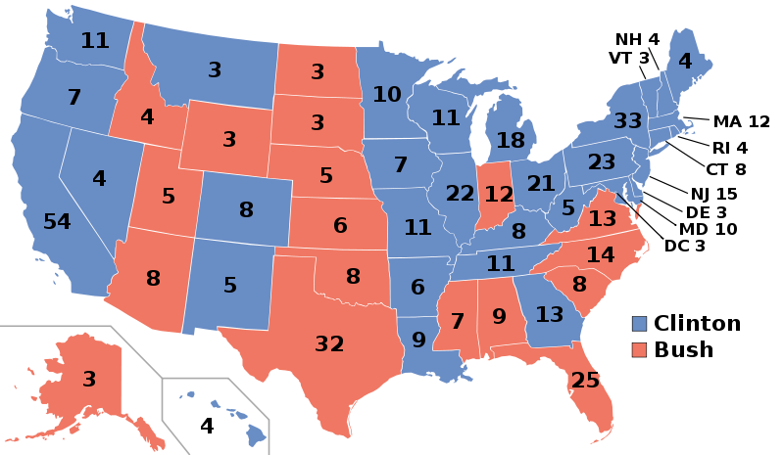
Candidate | Popular Vote | Electoral Votes
Bill Clinton | 43.0% | 370
George H.W. Bush | 37.5% | 168
Ross Perot | 18.9% | 0

Slide 33
Third Parties as “Spoilers”
Third Parties may pull votes away from major parties in close elections and help influence the outcome
Ralph Nader’s Green Party in 2000 helped Bush [Republican] defeat Gore [Democrat]

Slide 34
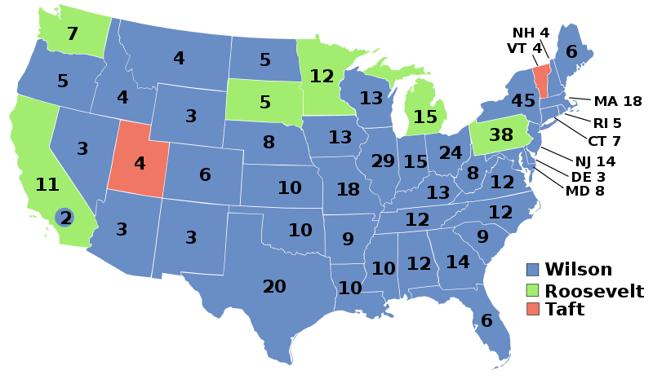
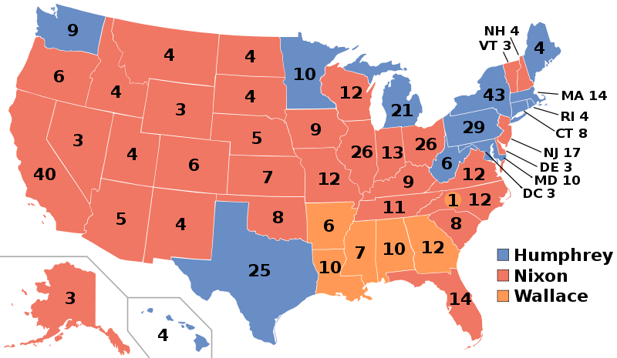
Candidate | Popular Vote | Electoral Vote
Wilson | 41.8% | 435
Roosevelt | 27.4% | 88
Taft | 23.2% | 8
Candidate | Popular Vote | Electoral Vote
Nixon | 43.4% | 301
Humphrey | 42.7% | 191
Wallace | 13.5% | 46

