Slide 1
Rise of Serial Killers during the 70’s in America

Slide 2
Background Knowledge
In 1972 the Behavioral Science Unit (BSU) was established as a training program of the Federal Bureau of Investigation (FBI)
The principal purpose of the BSU was to improve their comprehension of violent crimes and improve their effectiveness in carrying out operations
This program was not initially created as a result of a rise in crime
Profiling (suspicion for a crime based on race, ethnicity, etc) was developed by the BSU
The term “serial killer” was invented and first used by the BSU to describe a murder without a motive (Diane Dimond)

Slide 3
The Effect of the Cold War
The Cold War between the United States and the Soviet Union had been ongoing from 1945-1991
American focus scattered for the most part and otherwise was on foreign issues rather than domestic issues
Attention to the Vietnam War and Watergate scandal created a buffer for other social issues to emerge
Attention towards domestic issues gravitated heavily towards the Civil Rights movement and John F. Kennedy’s assassination which created a distrust for the government

Slide 4
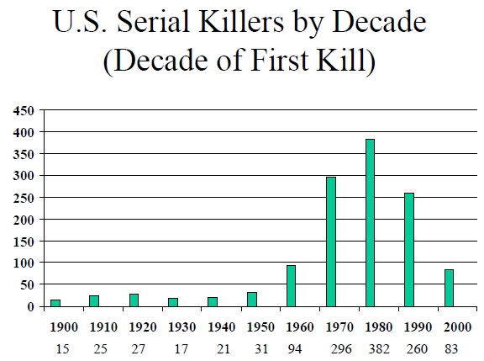
Rise in Murders
A rise in serial killing would begin in the decade of the 70’s, specifically the year of 1974
In the decade of 60’s there were only 156 active serial killers
By the 70’s there was a reported 450 active serial killers at work including some of the most notorious American serial killers (Diane Dimond)
After the year of 1980 there have only been 145 classified serial killers worldwide (Statistic Brain)
The current estimated number of active serial killers in the United States is 25 to 50

Slide 5
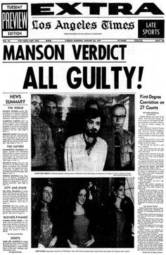
Prominent Serial Killers
There were several prominent American Serial Killers during the 1970’s
Ted Bundy
Zodiac Killer
John Wayne Gacy (Killer Clown)
Jeffrey Dahmer
David Berkowitz (Son of Sam)
Hillside Strangler

Slide 6
Video Presentation
http://www.biography.com/people/groups/serial-killers

Slide 7
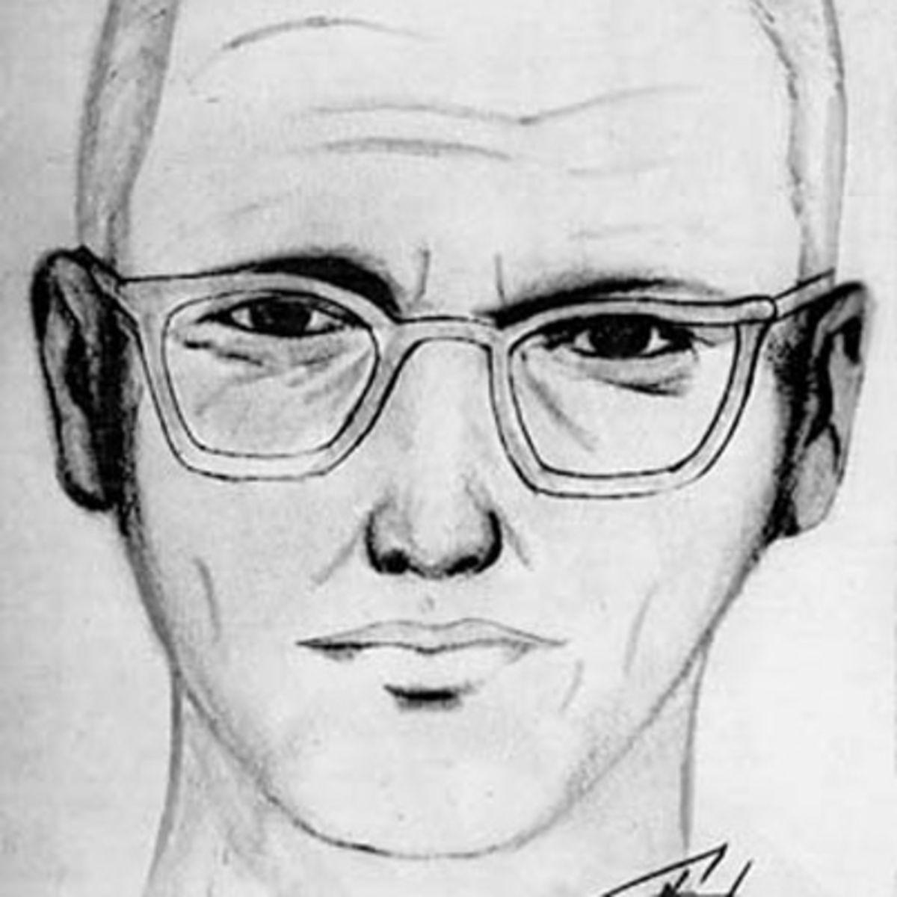
Zodiac Killer
Area Active: Northern California, San Francisco
The Zodiac Killer has been proven responsible for 5 murders in the late 1960’s (biography)
However, it is believed that he is responsible for
The Zodiac Killer is infamous and known for his intelligence in eluding law enforcement
He would often send cryptic letters to the local publication offices and communicate with law enforcement through them
It is believed he would leave clues towards his identity and taunted the police
Till this day he remains unidentified and his murders have gone unsolved

Slide 8
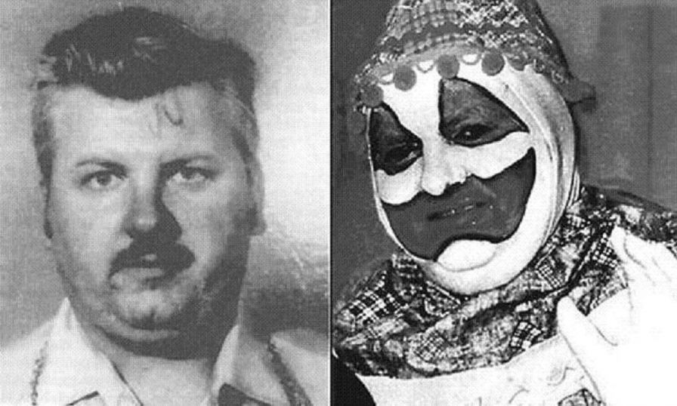
John Wayne Gacy (Killer Clown)
From March 17, 1942 to May 10, 1994
Prior to being a serial killer John Wayne Gacy was described as a friendly person and would perform for neighborhood parties as Pogo the Clown (Crime Museum)
Gacy began killing and raping around the year of 1976 without anyone having any knowledge of it
His targets were young men
He is infamous for the discovery of 29 dead people underneath his house
He murdered 33 people total
Convicted to Death penalty

Slide 9
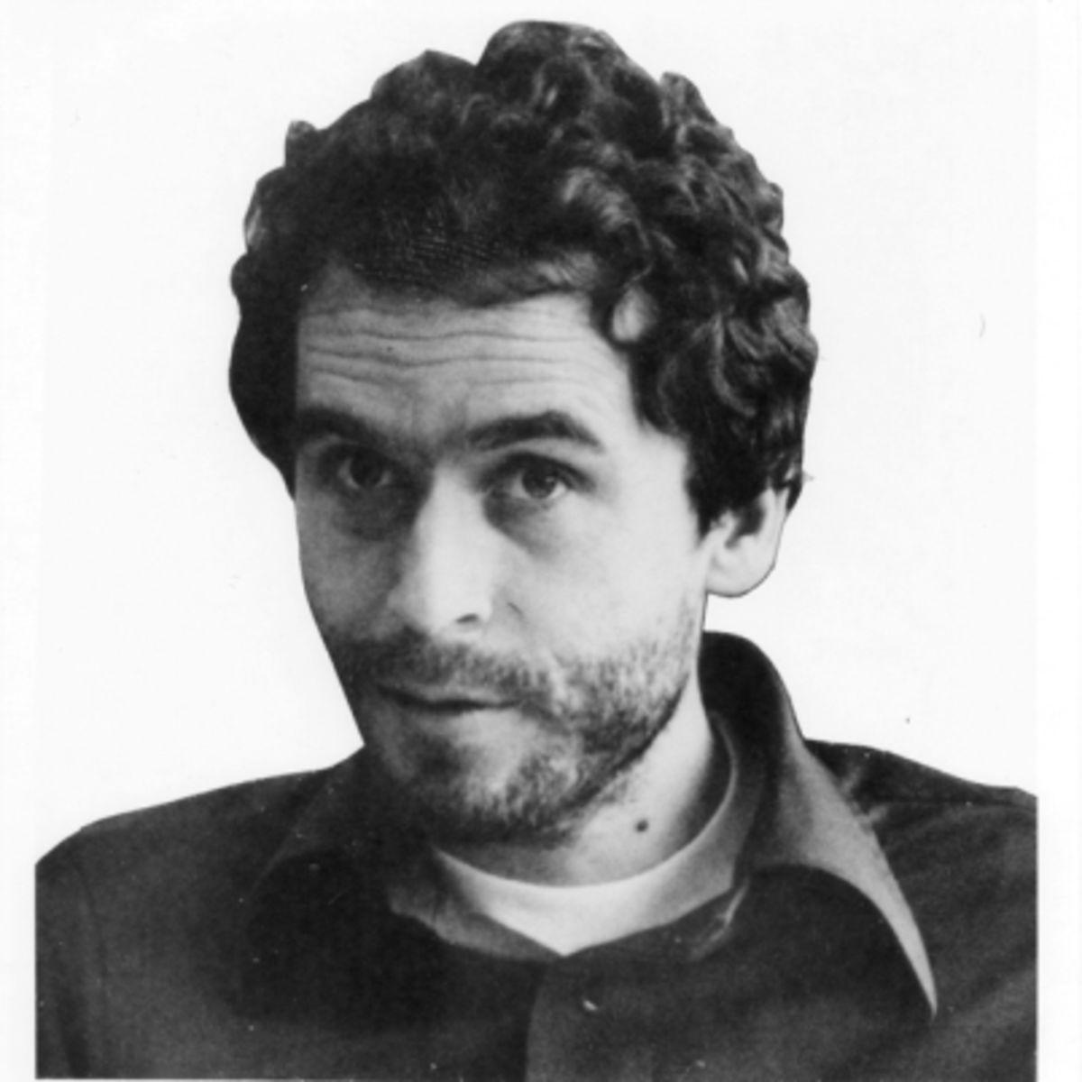
Ted Bundy
Active from 1973 to 1978 in several states across the country
Ted Bundy was an intelligent man who graduated from the University of Washington and attended law school
A large of amount of his victims would resemble the attractive appearance of his girlfriend who had long dark hair
He would target young women by killing and raping them
He openly admitted responsibility for the murders of 36 people although it is suspected he could be responsible for more than 100 (Biography)
He was sentenced the death penalty and was executed on January 24, 1989

Slide 10
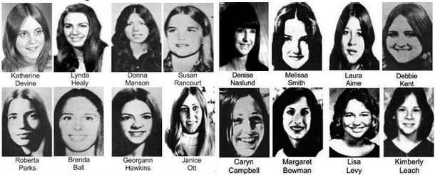

Slide 11
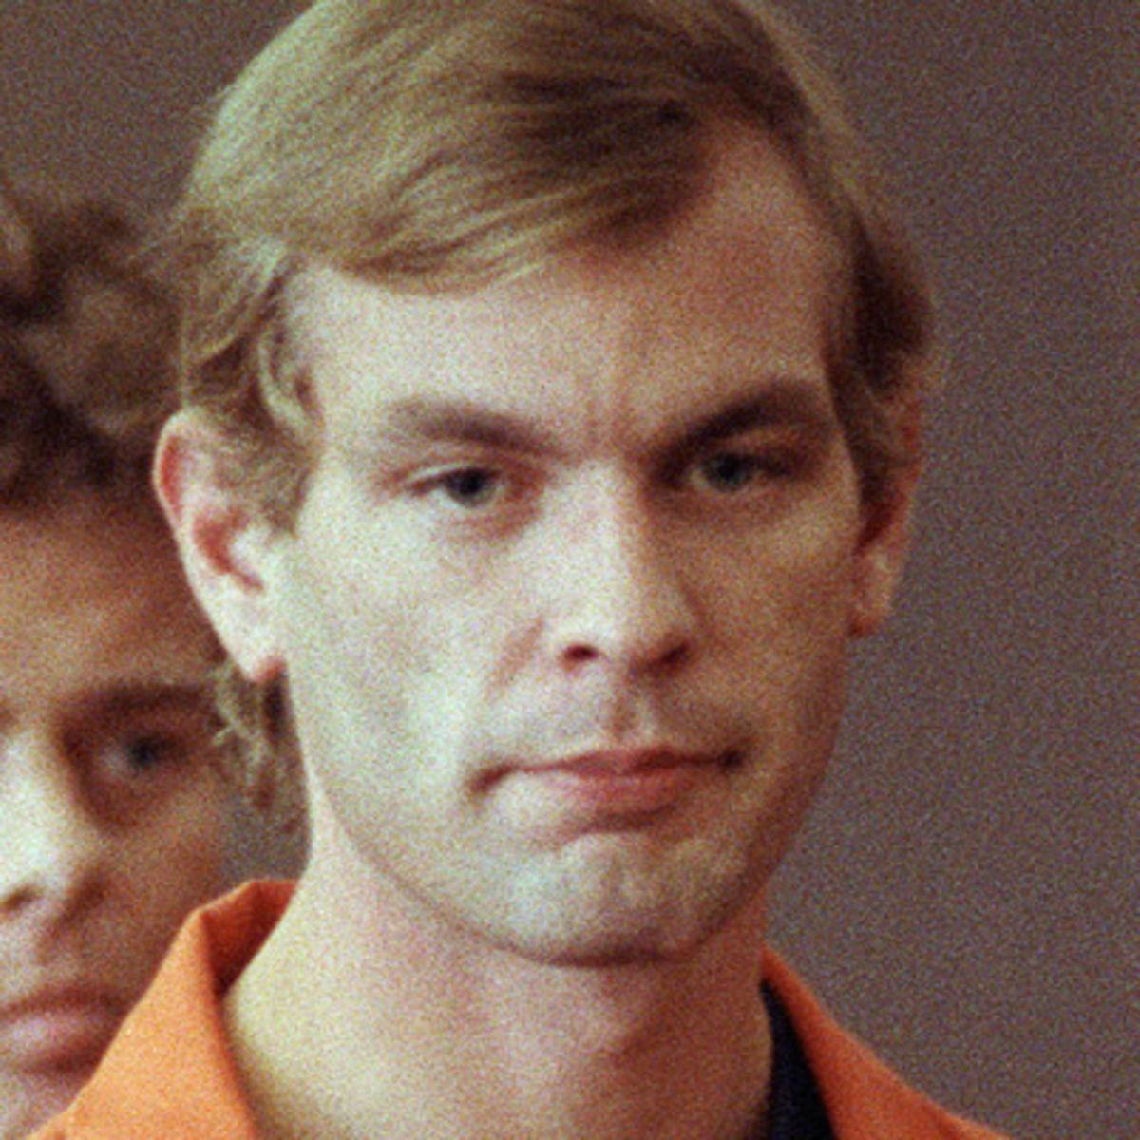
Jeffrey Dahmer
Jeffrey Dahmer was an infamous serial killer who began his “career” in the late 1970’s
He targeted men and often molested some of his victims once they were already dead (Biography)
His first kill was Steven Hicks which he dismembered and then buried in the woods behind his parent’s house

Slide 12
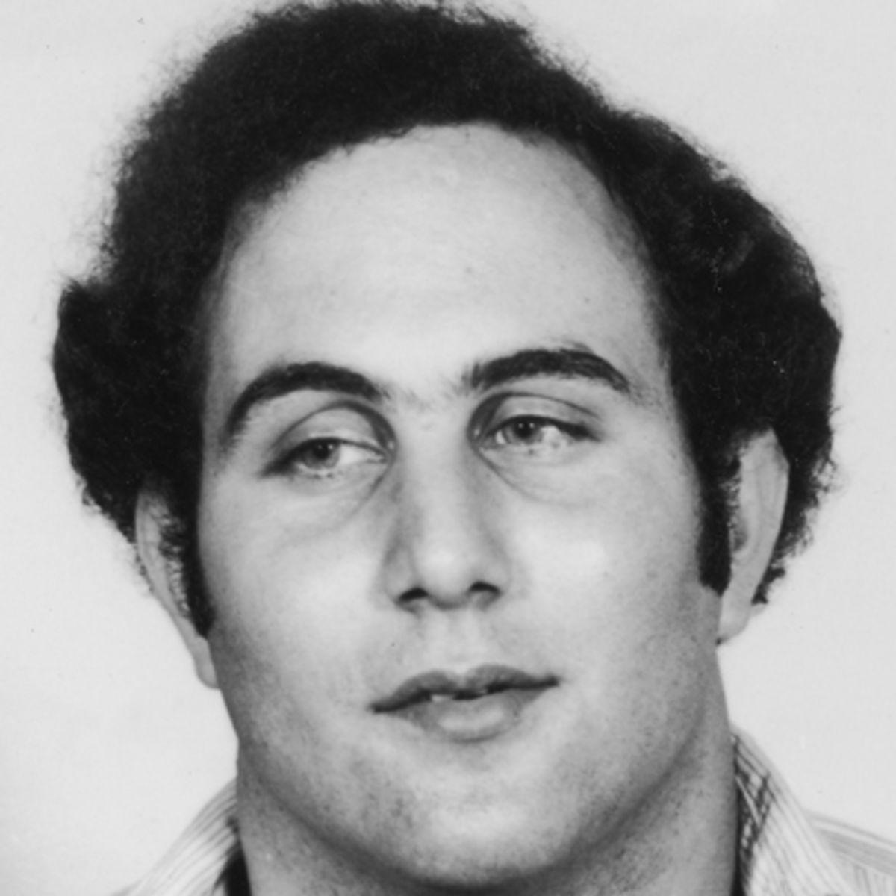
David Berkowitz (Son of Sam)
Area active: New York
Responsible for 6 murders from 1976 to 1977
All of his murders were executed with a .44 caliber gun
Berkowitz would leave letters to the police at the scene of the murder addressing himself as the “Son of Sam” (Biography)
Berkowitz tried to justify all his murders by saying that his neighbor Sam Carr would order him to carry out the killings through messages with his dog

Slide 13
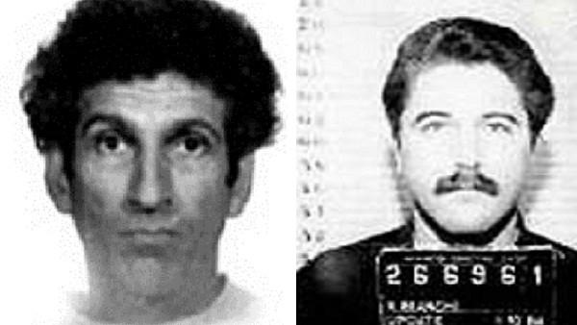
Angelo Buono & Kenneth Bianchi (Hillside Strangler)
Active in the Los Angeles area from 1977 to 1978
Their first victim was Yolanda Washington
Their usual method was to sexually assault, torture, and strangle their victim (female) to the death and then taking them to the hills where they would place the victim’s bodies in sexual positions (History)
Law enforcement believed the attackers to be one person thus their nickname
A total of 10 women were killed by the pair
Bianchi would kill an extra 2 women which would lead to their arrest

Slide 14
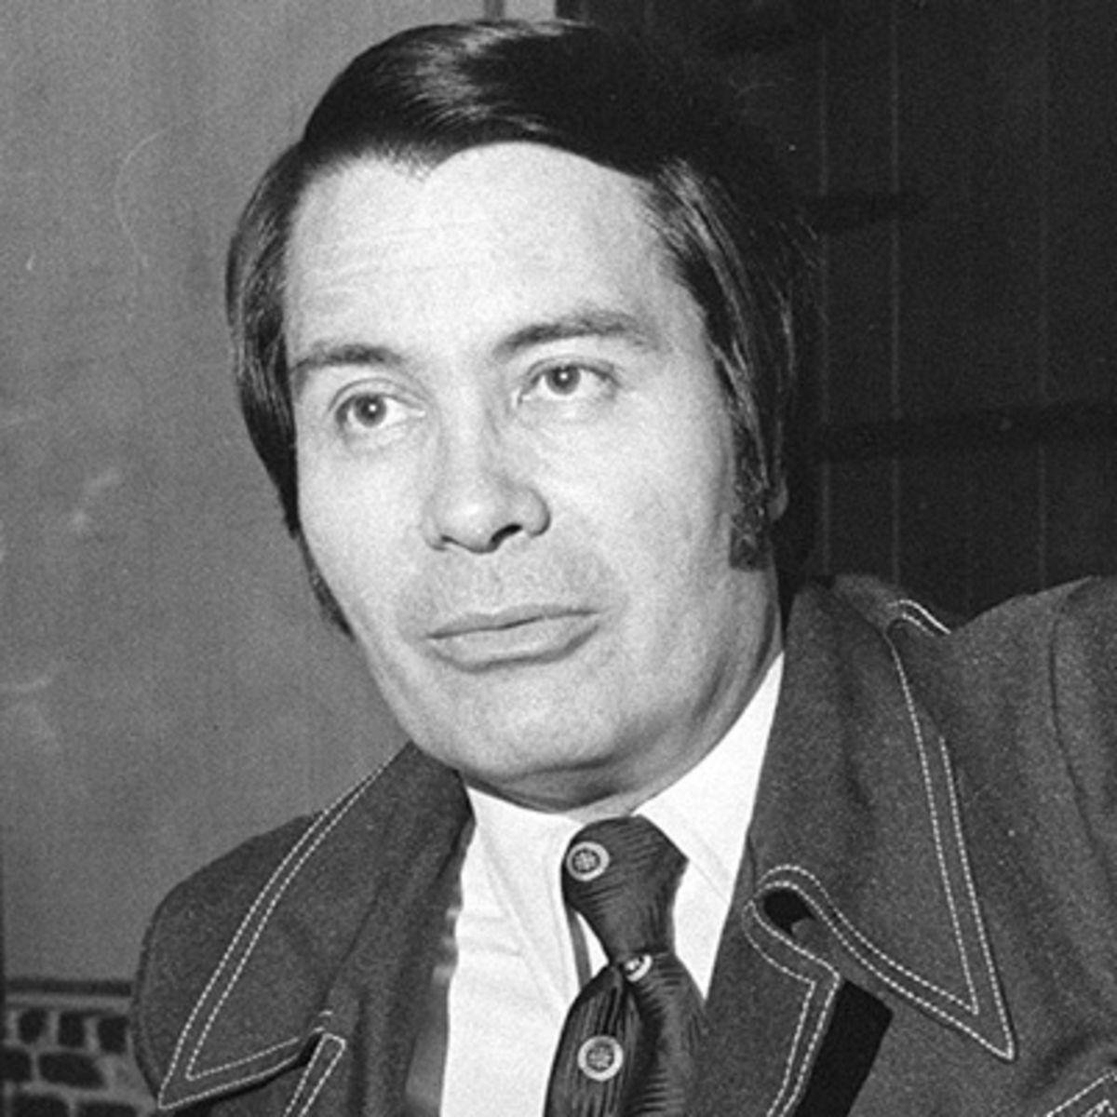
Jim Jones
Jim Jones was a cult leader of the People’s Temple
Jones at first gained the trust of his people by promising a Utopia, however he would go on to demand utter obedience and loyalty to him as time passed
He built his own compound where his followers and himself would live
Jones planned the murders of some of his followers and a California congressman after he attempted to rescue them
Jones then led a mass suicide taking the lives of 900 people

Slide 15
Works Cited Part 1
Bergeron, R. (15, August 17). 'The Seventies': The decade's worst killers. Retrieved May 26, 2016, from http://www.cnn.com/2015/07/08/entertainment/the-seventies-the-decades-worst-killers/
David Berkowitz. (n.d.). Retrieved May 26, 2016, from http://www.biography.com/people/david-berkowitz-9209372#arrest-and-imprisonment
Dimond, D. (14, June 02). The Year We Began to Understand Serial Killers. Retrieved May 26, 2016, from http://www.huffingtonpost.com/diane-dimond/the-year-we-began-to-unde_b_5077735.html

Slide 16
Works Cited Part 2
John Wayne Gacy. (n.d.). Retrieved May 26, 2016, from http://www.crimemuseum.org/crime-library/john-wayne-gacy
Statistic Brain. (n.d.). Retrieved May 26, 2016, from http://www.statisticbrain.com/serial-killer-statistics-and-demographics/
Ted Bundy. (n.d.). Retrieved May 26, 2016, from http://www.biography.com/people/ted-bundy-9231165
The Hillside Stranglers. (n.d.). Retrieved May 26, 2016, from http://www.history.com/this-day-in-history/the-hillside-stranglers

Slide 17
Works Cited Part 3
Zodiac Killer. (n.d.). Retrieved May 26, 2016, from http://www.biography.com/people/zodiac-killer-236027#synopsis

