Slide 1
Was the Civil War Inevitable?

Slide 2
The Civil War
(1861-1865)
Occured because of the political, economical, and social differences between the North and the South
Determined what kind of nation it would be
Resolved two fundamental questions left unresolved by the revolution:
Whether the U.S. was to be a dissolvable confederation of sovereign states or indivisible nation with a sovereign national government and whether this nation would continue to exist as the largest slaveholding country in the world
Northern armies were victorious and rebellious states returned to the Union

Slide 3
Political Causes of the Civil War
The Election of Abraham Lincoln
Lincoln won the election in 1860 as the first Republican president
South Carolina issued its “Declaration of the Causes of Secession”
believed the Lincoln was anti-slavery and in favor of Northern interests
Seven Southern states had seceded from the Union
South Carolina, Mississippi, Florida, Alabama, Georgia, Louisiana, and Texas

Slide 4
States’ Rights
Southerners felt that the Federal Government was passing laws that treated them unfairly
believed that states should have the right to not follow a law if it did not benefit them

Slide 5
Economical Causes of the Civil War
The North was economically dominant over the South
Northern economy relied on manufacturing
The Industrial Revolution in the North did not require slaves
Agricultural Southern economy depended on the production of cotton
The Souths need for slaves to pick more cotton strengthened their need for slavery

Slide 6
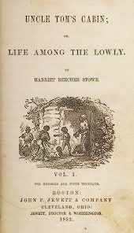
Social Causes of the Civil War
Growth of the Abolition Movement
Many abolitionists wanted to end slavery in the country once and for all
Led to Lincoln winning the election
Uncle Tom’s Cabin
Was written by Harriet Beecher Stowe, abolitionist,
to show the evils of slavery
Had a huge impact on the way northerners viewed
slavery and helped further the cause of abolition

Slide 7
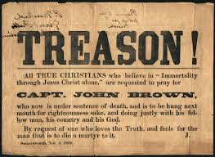
John Brown’s Raid on Harpers Ferry
John Brown was an abolitionist who had been involved in anti-slavery violence in Kansas
John Brown and a group of supporters went to raid the arsenal located in Harpers Ferry
His goal was to start an uprising using the captured weapons, however they were captured and eventually killed
This event was one more in the growing abolitionist movement that helped lead to open warfare in 1861

Slide 8
Lincoln’s Beliefs
Lincoln was not an abolitionist
although lincoln did believe slavery was wrong he did not want to go against the founding fathers since it was not mentioned in the constitution
Believed African americans shouldn’t be treated equally
he was accused by Douglass to want same race equality
Declared he did not want to make African Americans politically and socially equal

Slide 9
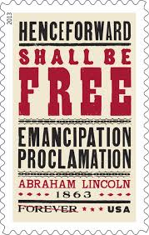
Emancipation proclamation
The Emancipation proclamation is a symbol of equality and justice
had a Positive impact
Presidential proclamation
issued by Lincoln in January 1, 1863
Declared that all slaves were to be free
only applied to rebellious slave states

Slide 10
Life during the Civil War
Families split
Brothers fought with brothers on opposite sides of war
in many families the only people left were the mothers and daughters
Public support weakened on both sides
less and less people wanted to fight
most fighting took place on southern land
In 1863 they drafted a law that men from ages 20-45 should be drafted to go to war

Slide 11
South Vs. North
wanted to keep slavery
had large farms/ plantations and wanted to keep slavery for harvest
Better Military leadership
Robert E. Lee
Stonewall Jackson
Nathan Bedford
wanted to abolish slavery
didn’t have much farmland
Much larger population
Had 71% of population
Had a better economy

Slide 12
Would the Civil War have occurred if…
Abraham lincoln would have not been elected?
Yes
The civil war was already beginning due to other situations such as
John browns raid
Conflicts between North and South due to slavery
States versus federal rights

Slide 13
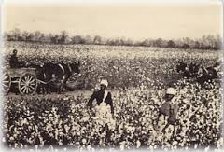
Was the Civil War inevitable?
The causes made the conflict between the south and the north almost impossible to resolve
The North and South economies were different
The war was inevitable given the circumstances under which it came
The south was very persistent about wanting to keep slavery and they wanted it to spread into the North
They wanted to keep slavery because
they had many plantations

Slide 14
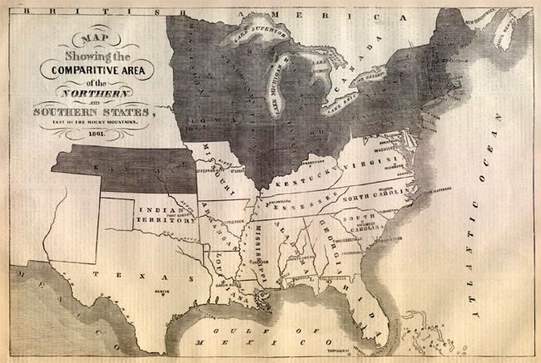
South relied on slaves to run the large plantations that they owned
A conflict was unavoidable because of southern states had a lot of plantations and farms
North disagreed completely: they wanted it to
be abolished completely
Different opinions about the issue of
slavery and politics

Slide 15
Citations
"Causes of the Civil War." American Civil War Center. Web. 10 Nov. 2014.
"Causes Of The Civil War." History Net Where History Comes Alive World US History Online RSS. Web. 10 Nov. 2014.
“Abraham Lincoln. “council on Foreign Relations. Council on Relations. web.14 Nov.2014
Thadani, Rahul. "Was the Civil War Inevitable?" Buzzle. Web. 17 Nov. 2014.
"Civil War Facts." History Net Where History Comes Alive World US History Online RSS. Web. 19 Nov. 2014.

