Slide 1
The Great Depression

Slide 2
Changes in the United States

Slide 3
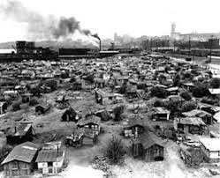
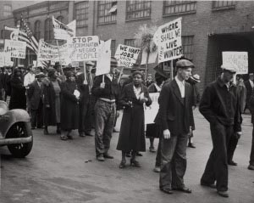
Changes in the United States
Social:
Family income dropped 40%
Agricultural prices dropped
Farmers were greatly affected; they lost their jobs and became homeless

Slide 4
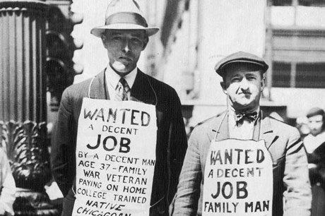
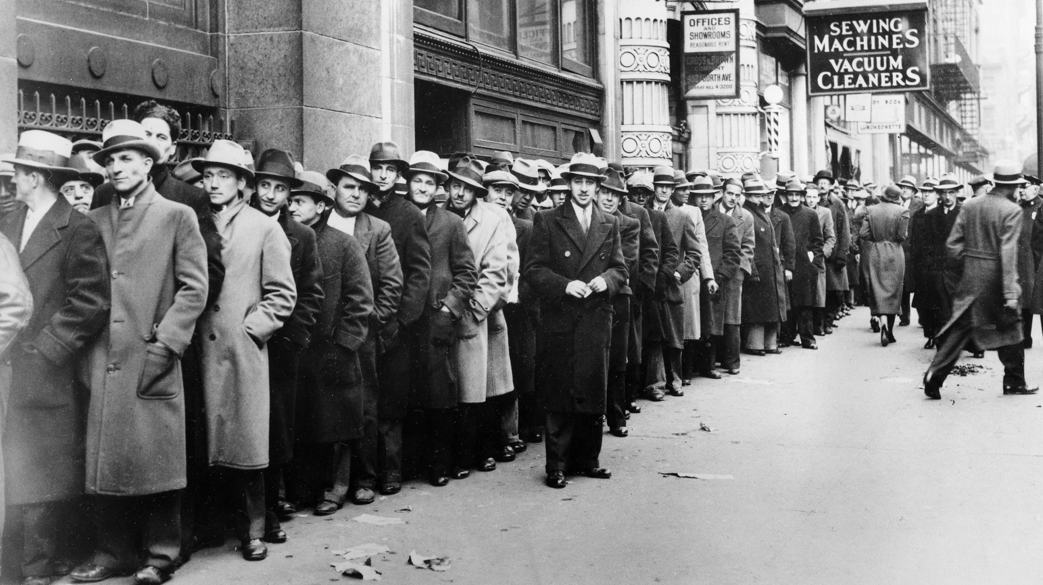
Changes in the United States
Social:
6,000 shantytowns (Hoovervilles) ("The Great Depression and the New Deal," Stanford University. "Shanty Town Facts," American Historama.)
By 1933 unemployment was 24.9%, about 15 million were unemployed

Slide 5
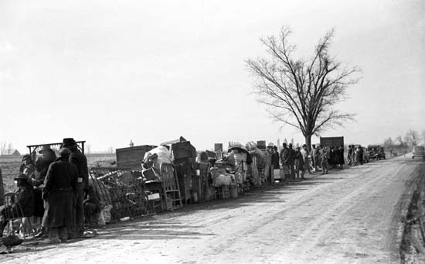
Changes in the United States
Economy:
The first few years the economy shrank 50%
650 banks failed in 1929
They shut down banks because of the chaos
Stock market value decreased

Slide 6
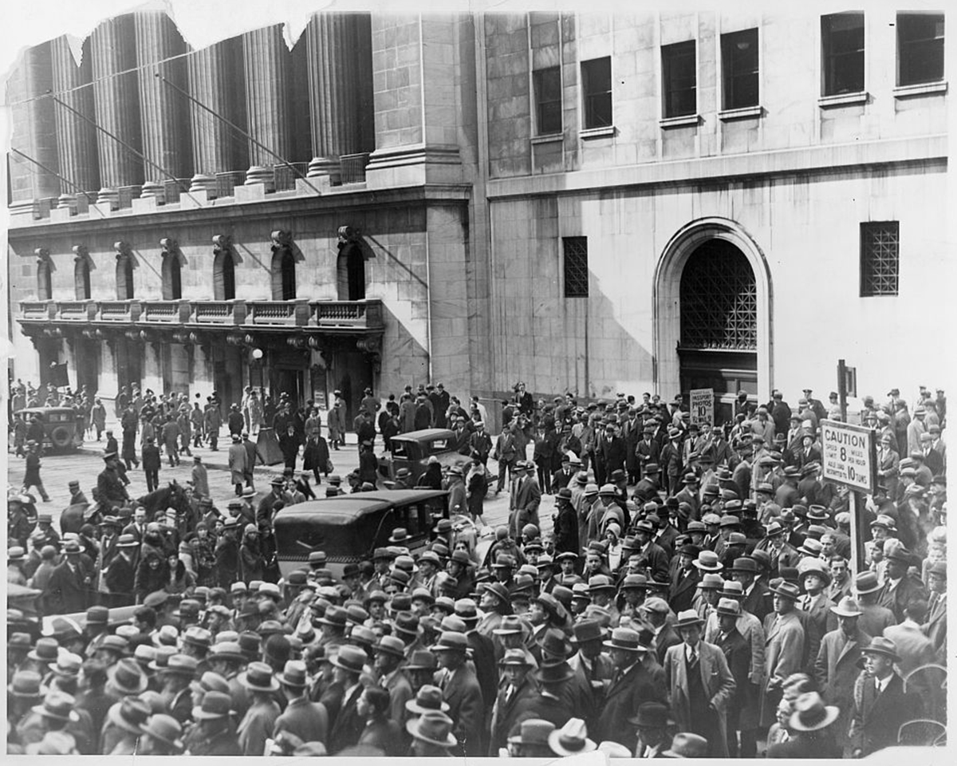
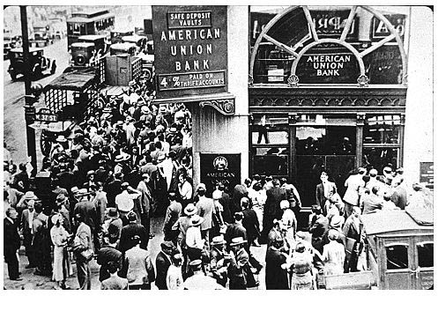
Changes in the United States
Economy:
Economy gradually grew
Shrank 3.3% when The New Deal spending was cut back
People who did or didn’t invest were left with no money
Banks invested money from people so they lost their money
(“Effects of the Great Depression,” Kimberly Amadeo)

Slide 7
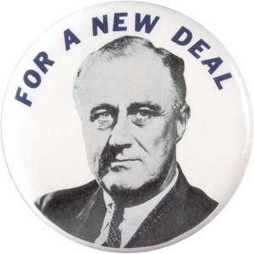
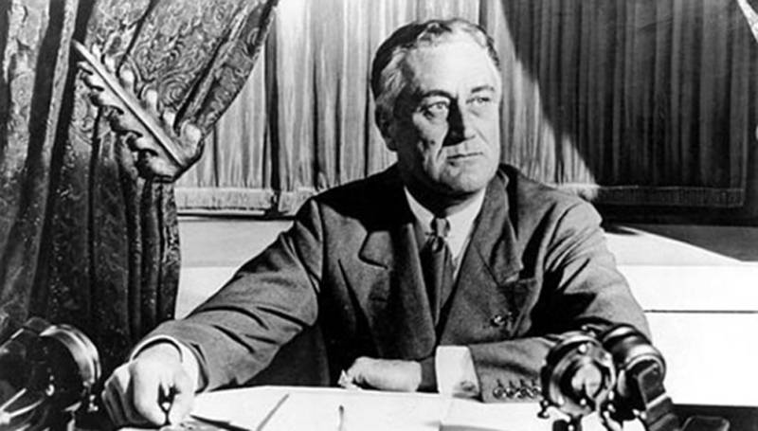
Changes in the United States
Politically:
Herbert Hoover and his capitalist ideas failed
The New Deal created by Franklin D. Roosevelt almost ended the Depression

Slide 8
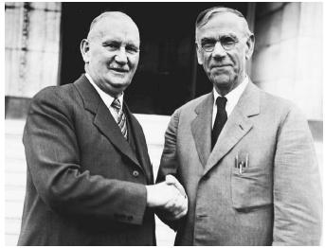
Changes in the United States
Politically:
The economy grew because of some of the New Deal programs
Unemployment decreased
Hawley-Smoot Tariff, world trade went down 65 percent
(Kimberly Amadeo “Effects of The Great Depression”)

Slide 9
The New Deal in the Great Depression

Slide 10
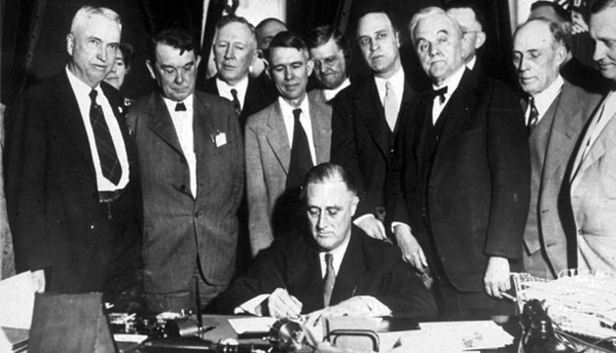
FDR’s New Deal
Franklin D. Roosevelt’s “New Deal” consisted of programs to help people and the whole nation reform, relief, and recover from the depression
Addressed all the issues in the U.S.

Slide 11
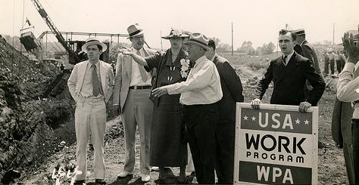
FDR’s New Deal
First addressed unemployment
Works Progress Administration (WPA)
Civilian Conservation Corps. (CCC)
These programs helped give temporary jobs and short-term aid

Slide 12
FDR’s New Deal
Next Roosevelt wanted to revive industrial activity
National Recovery Administration (NRA)
Wagner Act
Helped regulate wages, child labor, and collective bargaining

Slide 13
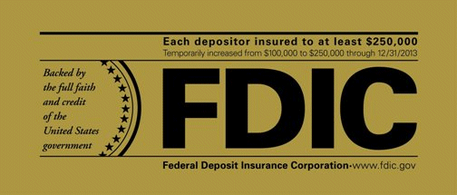
FDR’s New Deal
Franklin Roosevelt wanted to make sure the stock market wouldn’t crash again
Federal Deposit Insurance Corporation (FDIC)
Securities and Exchange Commission (SEC)
Insurance for bank members and protected investments

Slide 14
New Deal Used Today

Slide 15
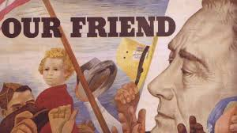
New Deals Today
There are three New Deals still used today...
Federal Deposit and Insurance Corporation (FDIC)
Securities and Exchange Commision (SEC)
Social Security

Slide 16
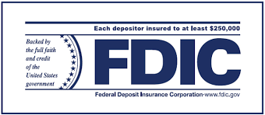
FDIC
Controls personal finances
Provides financial insurance to banks and leading institutions to encourage to set up bank accounts and make deposits
Protects bank accounts by up to $100,000

Slide 17
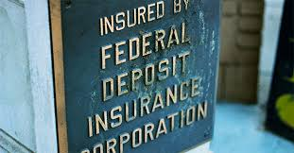
FDIC
Financial Insurance
Allows banks to loan and lend money with assurance
Movement of money throughout economy

Slide 18
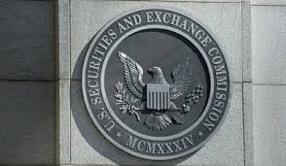
SEC
Protects investors
Helps with economic stability for long-term
Creates transparency in the federal government system
Requires disclosure of specific information by public companies to help
Investors
Brokers
Determine to make investments in a certain company

Slide 19
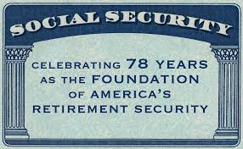
Social Security
Social Security taxes go into special funds
Head of family died or retires, payments are made from funds
Replaces the earnings the family lost
Protection
Tracks people down

Slide 20
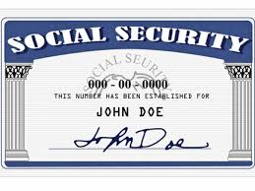
Social Security
Disability Benefits:
If disabled, monthly payments are paid to them and their families
Survivors Benefits:
Widows age 62 and older and children under 18 get lump sum death payment

Slide 21
Works Cited
Amadeo, Kimberly. "Effects of the Great Depression." The Balance. N.p., 09 Mar. 2017. Web. 31 Mar. 2017.
"New Deal." Encyclopaedia Britannica. Ed. Encyclopaedia Britannica. N.p., 4 May 1999. Web. 7 Apr. 2017.
"The New Deal, Then and Now." The Gilder Lehrman Institute of American History. N.p., 14 July 2012. Web. 10 Apr. 2017. <https://www.gilderlehrman.org/history-by-era/new-deal/essays/new-deal-then-and-now>.

Slide 22
Continued
Susan Sward - Special to The Bee. "New Deal: An example for today?" The Sacramento Bee | Sacbee.com. N.p., n.d. Web. 10 Apr. 2017. <http://www.sacbee.com/opinion/california-forum/article2596872.html>.
"What New Deal programs are still in effect today?" Reference. N.p., n.d. Web. 10 Apr. 2017. <https://www.reference.com/government-politics/new-deal-programs-still-effect-today-b8b63d0222d38633>.
"New Deal Today." Living New Deal. N.p., n.d. Web. 10 Apr. 2017.

