Slide 1
Supply and Demand
MT 2.1

Slide 2
Goals
Know what the laws of supply and demand are and how they work in the real world
Analyze the effect outside forces have on supply and demand
Diagnose the elasticity of goods and services and how to predict them
Examine how the equilibrium price is found, and how it is used to predict shortages and surpluses

Slide 3
Questions to think about
Why do you think some goods are more expensive than others?
What causes people to want one good more than another, even if they are nearly identical?
Why do people’s tastes change?
What can cause prices to change for the same good?

Slide 4
What is demand?
Definition: The desire, willingness, and ability to purchase a product at a given price.
Law of demand: when the price of a good increases, the demand for the same good tends to decrease and vice versa.

Slide 5
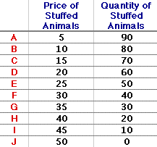
Demand Schedule
The amount of goods demanded at different price levels

Slide 6
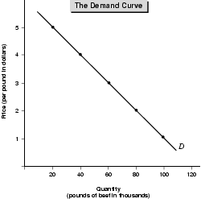

Slide 7
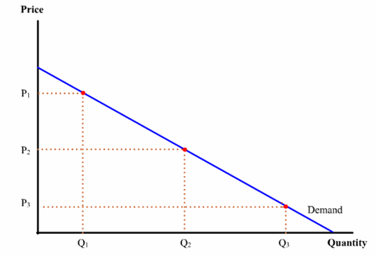

Slide 8
Outside forces that effect demand
Substitution Effect:
If the price of an item rises and there are substitutes for that item, the demand will go down.
Income Effect:
As prices go up, you feel like you have less money, therefore you are able to buy less, or not buy it at all.
Consumption goes down.

Slide 9
Factors that shift the demand curve
Amount of substitutes available
Prices and demand of a complementary item
Change in taste of consumer
Amount of income one has
Outlook on the future
Number of consumers

Slide 10
Demand Elasticity
The responsiveness of demand to changes in price for a particular good
Is it elastic, inelastic, or unit elastic?
Elastic: Small change in price = big change in demand
Snack food, fast food, head phones, some clothing…
Inelastic: Big change in price, little to no change in demand
Gas, sporting events, surgery, etc…
Unit elastic: Price changes 10%, demand also changes 10%

Slide 11
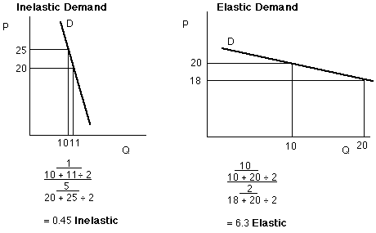

Slide 12
Determinants of elasticity
Importance of good to consumer
Necessity or luxury
What substitutes are available?

Slide 13
Supply
Definition: The amount of goods and services that suppliers are willing and able to produce at a given price
Law of supply: that when all else is equal, an increase in the price people are willing to pay for a product, increases the desire of the producer to supply more of that product.
If price increases, supply will increase as well if possible.

Slide 14
Questions on supply
how much to produce to get the highest profit possible
Ideally no surplus and no shortage
How many laborers are needed to be as efficient as possible?
Law of diminishing returns….
Marginal costs v. marginal benefit
How much does it cost to make?
Fixed v. variable costs
Total costs

Slide 15
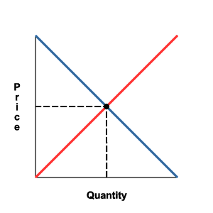

Slide 16
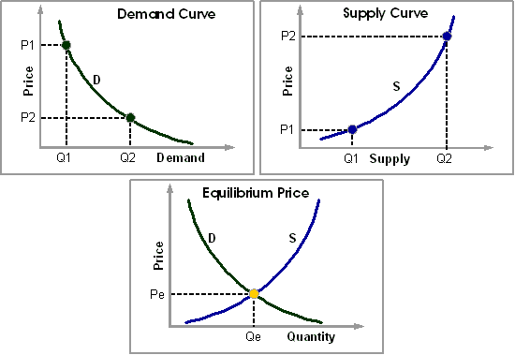
Surplus here
Shortage here

Slide 17
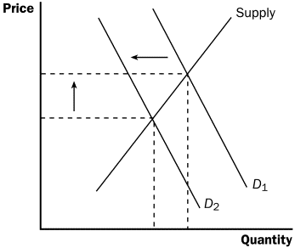
Shift in demand cause EQ price to change.

Slide 18
Review
How do supply and demand graphs differ?
If the price of a substitute good drops, what happens to the demand of its competitor? Ex.. Honda v. toyota
What happens to the market demand curve if a large number of people leave an area?
What is created when you are producing at a price above the equilibrium price?
What type of elasticity should brand names have?
If you cannot wait to purchase a good or service, what type of elasticity do you have? Ex…Gas in the desert…
Why is it hard to gauge the correct # of laborers to hire?

