Slide 1
Scarcity Notes
Econ MT 1 LT1

Slide 2
Intro
What is economics?
Why study it?
  Do you get everything you ever want?
    Why not?

Slide 3
What is Economics?
The main problem we study in economics, is scarcity. Econ does not exist without scarcity
Definition:
  The study of the way people make decisions on the use of their scarce (limited) resources to satisfy our unlimited wants and needs
In essences: Wants v. Needs

Slide 4
SCarcity
Natural resources are limited, people’s wants and needs are unlimited, therefore….
Decisions must be made on how to use the limited resources
If you use your resources to satisfy one want, you cannot use the same one to satisfy another
What is your most valuable resource?

Slide 5
Because of scarcity, strange occurrences happen…
Such as: There is No Such Thing As A Free Lunch!
  Due to limited resources, anything you get “for free” is only free in a sense. You still spent your valuable resources on a “free” want or need.
  Why is the “free lunch” here at school not really free to you?

Slide 6
Scarcity Causes choices
Choices = sacrifice.
  You must give something up every time you make a decision
  What you give up is called an opportunity cost (LT 2)
The more uses a scarce resource has, the more valuable it should be
Paradox of value: Observation that articles or goods critical to life (such as water) are very cheap, whereas others which have no bearing on human existence (such as diamonds) are very expensive.

Slide 7

Who makes these decisions?
Consumers – the people who decide to buy things
What is the incentive of the consumer?
  Get the most of what they value from their expenditures, BUT they are constrained by their budget.
In essence: what utility do I get from the use of my resources? (satisfaction)

Slide 8
What’s the Difference between a Need and a Want?
NEEDS
WANTS
Those goods and services that are necessary for survival
Food, clothing, shelter
Those goods and services that people consume beyond what is necessary for survival
Luxuries…

Slide 9

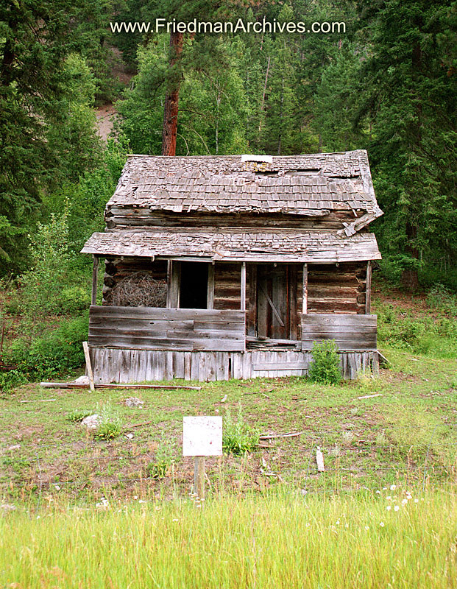
Need or want?

Slide 10

Need or Want?

Slide 11
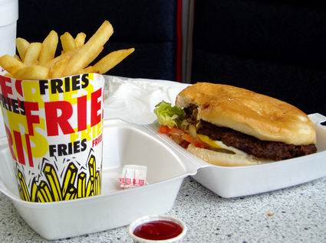

Slide 12
Human wants are:
a) Always fixed
b) Limited
c) Unlimited
d) Likely to decrease over time

Slide 13

Producers – The people who make the things that satisfy consumers’ needs and wants.
What is the main incentive of the producer?
  Provide consumers with what they value the most while covering their costs of production and making a profit.

Slide 14


What are goods and services?
GOODS
SERVICES
Physical objects that can be purchased
Pizza, bicycle, shoes
Actions or activities that are performed for a fee.
Lawyers, teachers, plumbers

Slide 15
3 Basic Economic Questions
What to produce?
Who to produce it for?
How to produce it?

Slide 16
Four Economic Resources (Factors of Production)
Land
Labor
Capital
Entrepreneurial ability
Copyright ©2002 by The McGraw-Hill Companies, Inc. All rights reserved.
2-5

Slide 17
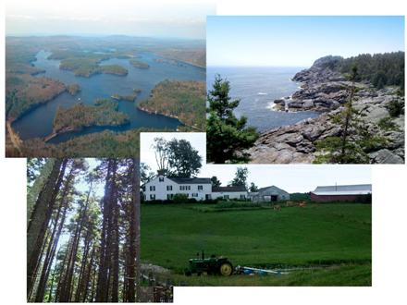

Slide 18



Slide 19




Slide 20
What is the main problem that economics studies?
What is the difference between a need and a want?
What is the main goal of producers?
Every decision we make comes with an …
Natural resources are… but people’s wants are…
Scarcity always requires people to do what?
Why can you not go to the store and buy everything you want?

Slide 21
Key Questions:
What are the country’s natural resources?
What are the primary goods produced in the country? Why?
How does the country compensate for their scarcity of resources with trade-offs?
What role do needs and wants play in the economic decision making process?

