Slide 1
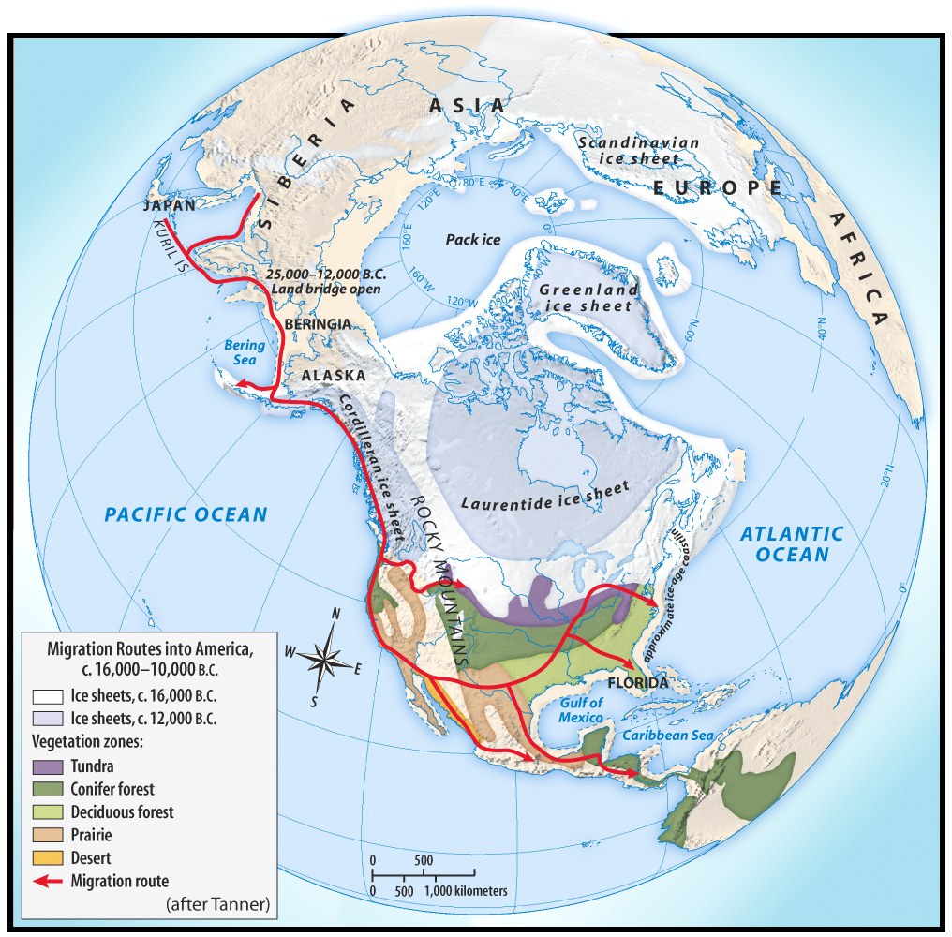
Pre-Columbian time period.
First Americans came from Asia
Crossed the Bering Strait during the Ice Age
Following a food source
Gradual migration

Slide 2
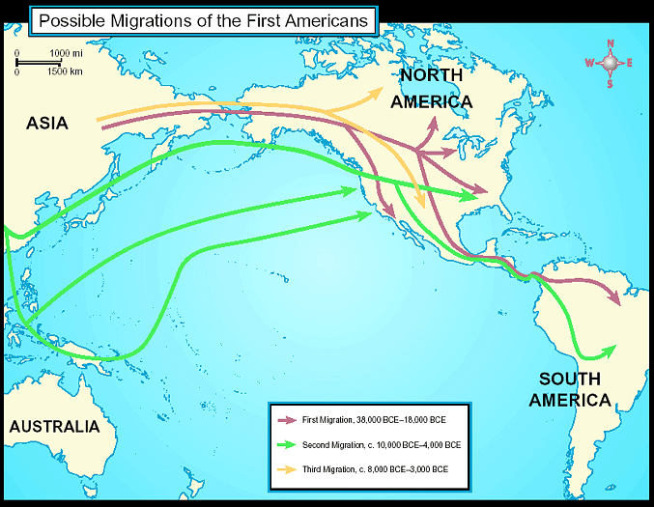
Early Human Migrations
    1st Migration, 38,000-1800 BCE
    2nd Migration, c. 10,000-4,000 BCE
    3rd Migration, c. 8,000-3,000 BCE

Slide 3
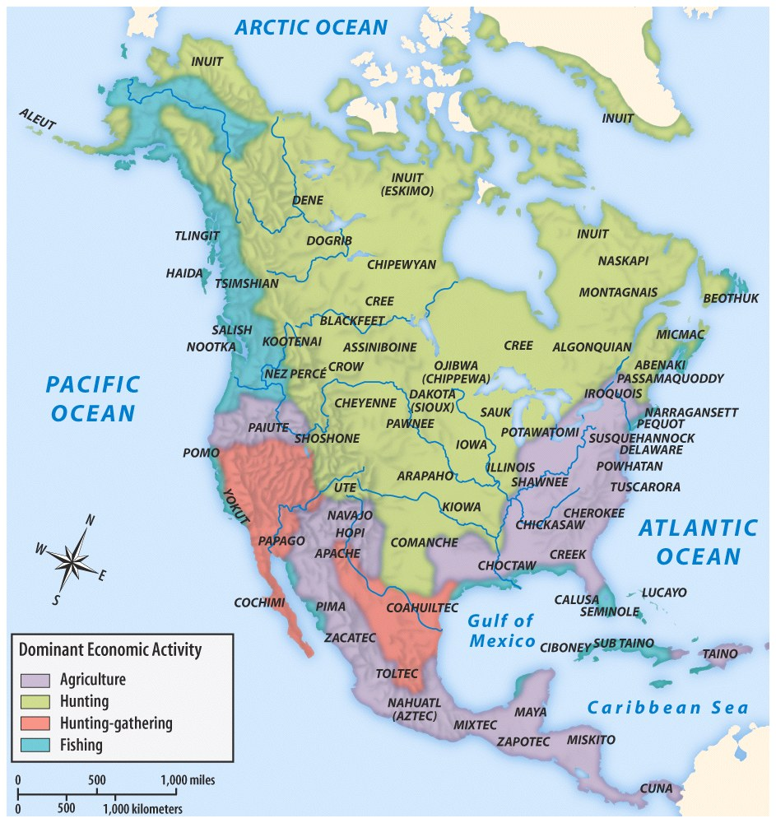
Culture area
CULTURE AREAS OF NATIVE AMERICANS

Slide 4
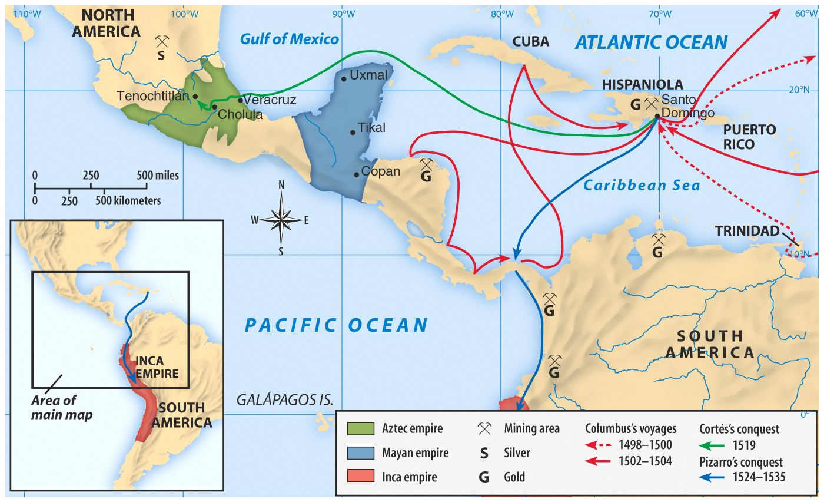

Slide 5
Clash of cultures
Why were there major clashes between ways of life of the natives and the Europeans?
How did the Europeans come to dominate so much of the “New World?”

Slide 6

clash
CULTURAL CLASHES
WHITE EUROPEANS
Used the land for economic needs
Clearing the land, destroying hunting areas and fencing it off into private property
Divided the land and selling it for monetary value.
NATIVE AMERICANS
Relationship with environment as part of their religion
Need to hunt for survival
Ownership meant access to the things the land produced, not ownership of the land itself.
VS

Slide 7
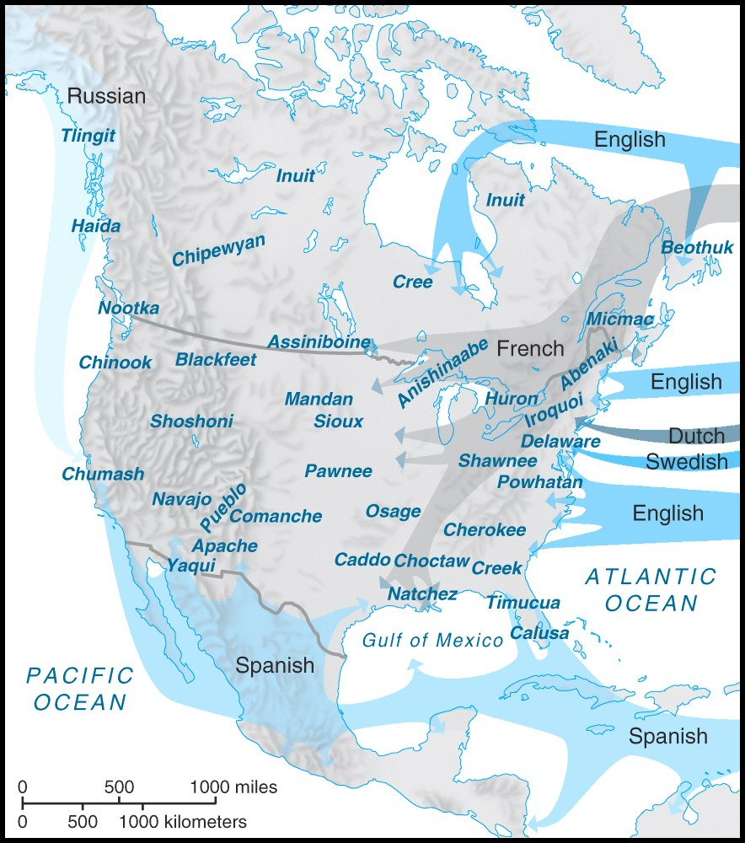

European movement
EUROPEAN MOVEMENT ONTO INDIAN LAND

