Slide 1
Great Depression
Great Recession

Slide 2
Overview
People have been comparing the Great Recession of 2008-2010 to the Great Depression of 1929-1939 for a while, but looking at both events there are similarities, but despite the similarities, the Great Recession was not as grave as the Great Depression.

Slide 3
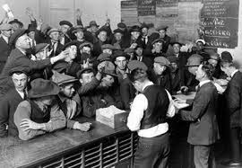
Great Depression
Worst economy in the United States
Also affected other nations
Officially lasted from 1929 through 1939
Factors leading to the Great Depression
October 29, 1929 Stock Market Crash
Buying stock on margin
Overproduction of goods
Buying on credit
Unequal distribution of wealth
Foreign Trade
Federal Reserve
Hawley-Smoot Tariff

Slide 4
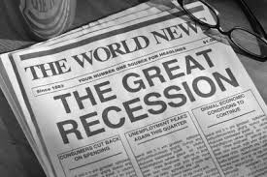
Great Recession
Biggest economic downfall since the Great Depression
Affected other nations
Officially lasted from December 2007 through June 2009
Still haven’t recovered fully , nor returned to the economy from before the great recession
Factors leading to the Great Recession
Cutbacks in consumer spending
U.S. Financial institutions convinced people to buy homes they couldn’t afford (Rosner)
Created an economy crash in real estate
Fragile Banks (fee)
Unbalanced international trade
Debt

Slide 5
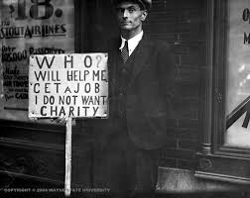
Great Depression: Jobs
Mass Lay offs
Unemployment
1 in every 4 of the population was unemployed (Redmond)
3 million in 1929, 4 million in 1930, 8 million in 1931, and 12 ½ million 1932 (Asgmnt 4 Document A)
Minorities were the first fired last hired
Those who did have jobs didn’t have the best working conditions
Low pay
At times they were paid cents
Long hours
Bad working conditions

Slide 6
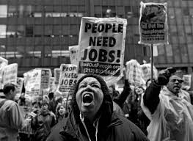
Great Recession: Jobs
Labor market Shed 6.1% of all payroll employment (State of working America)
Mass layoffs
Unemployment
December 2007 national unemployment rate was 5.0% the rate keeped increasing in June 2009 it was at 9.5 % and on October 2009 it was at 10% (BLS)
Hour cuts
Wage cuts
Minorities have a higher unemployment rate than white workers
More job seekers than job openings
Ratio of 5 to 1 in September 2010 (State of working America)

Slide 7
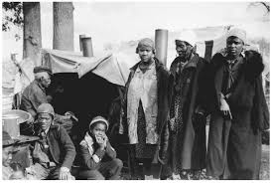
Jobs: How do they compare?
Similarities:
Unemployment
Mass lay offs
Less jobs per year
Minorities at disadvantage
DIfferences:
Unemployment rates
Work hours
Working conditions
Pay

Slide 8
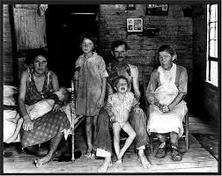
Great Depression: Daily Life
Families income decreased by about 40 percent
Marriage rates declined
Divorce rates declined
Couldn't afford lawyers
Men would apart themselves from family they were ashamed
Drank, Smoke, Left in long trips (trains), abandoned families
Entire families often lived in bad conditions
Overcrowded apartments
Homeless
Hoovervilles (Shacks)
Depended on
Soup Kitchens, Charities
Coped
Raido, Movies

Slide 9
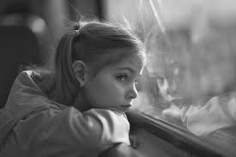
Great Recession: Daily Life
55% of all adults have experienced work related hardship (Pew)
Average American Household decreased by about 20% (Warner)
On average Household income declined by at least 25% (Warner)
BIrth rate is declined
Cut down on budget for luxury spending
Less materialism
Coped by “togetherness” among family and friends
Closer families
Attended public parks, beaches, stay at home activities
Togetherness wasn’t good for every family
Parents depressed, kids and teens separated themselves
Divorce rates declined beacuse it was too expensive
Family conflict and domestic violence rate increase (Warner)

Slide 10
Daily Life: How do they compare?
Similarities:
Majority of the people affected
Divorces decline
Size of families decrease
Family member pull themselves away from the rest of the family
Differences:
Men had way more pride
More homeless
Worst living conditions
Income decreased more in The Great Depression than in The Great Recession

Slide 11
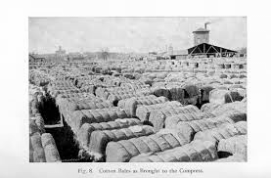
Great Depression: Industries
Almost all Industries are affected
Examples:
Farming
Banks
Textiles
Coal mining
Oil
Overproducing
Investing in products but americans didn’t have the money to pay for the products
Lost money
Lower Labor demand
Debt
Bankrupt

Slide 12
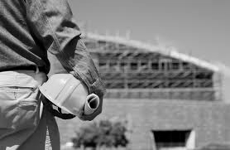
Great Recession: Industries
Industries largely affected (Tasci & Linder)
Construction
Housing markets
Real Estate
Insurance
Losing money
Lower demand for labor
Companies were in debt (Forbes)
Companies faced Bankruptcy (Forbes)

Slide 13
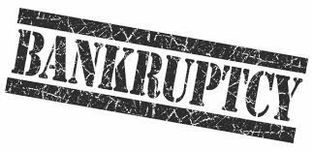
Industries: How do they compare?
Similarities:
Industries are negatively affected
Debt
Bankruptcy
Differences:
Different industries
Industries in the Great Depression were overproducing

Slide 14
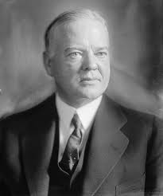
Great Depression: President(s)
Herbert Hoover
1st response was to do nothing
Later responses
Talked to business trying to convince them to invest more money to try and “jump start” the economy
Limited the money spent by government and raised taxes
Congress
Shoot-Hawley
Federal Reserve
Regulate U.S. banking industry, loaned money to the banks, lowered interest rates

Slide 15
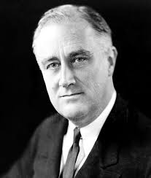
Great Depression: President(s) Continued
Franklin D. Roosevelt: FDR
Relief, Recovery and Reform
Relief: Goal was for the government to help people who were in serious need
Job Programs, Low interest loans, Direct relief
Recovery: Goal was to return the economy to pre-depression levels
Lowered the production to meet the demand, regulate industry, and economic recovery
Reform: Goal was to reform america’s finances
Restore faith in Banks, Federal Reserve Act, Federal Deposit Insurance Corporation, Government regulation of the stock market
The programs that FDR created put the United states in a great debt

Slide 16
Great Recession: President
Barack Obama: 44th President of the United States
Raised taxes
Talked about balancing the federal budget but spent massive amounts of money (FEE)
Increase in federal debt
Spent on interest groups
Signed into law
$787 billion stimulus package with the purpose of sending tax dollars to cities and voting groups across the U.S. (FEE)
Health insurance bill
Jobs bill
Send money to key congressional districts

Slide 17
Presidents: How do they compare
Similarities:
Taxes were raised
Government in debt
Bills were passed
Differences:
Great depression presidents did so much more work

Slide 18
Overall
I believe that even though the Great Recession wasn’t as severe as the Great Depression it did resemble what was happening during that time period. It has similarities in various areas such as the loss of jobs in both events but the Great Recession didn’t have the same unemployment rate as the Great depression. Daily life was hard in both occasions but people who lived through the Great Depression suffered more. Industries weren’t affected to the same extent in comparison to the effect that industries had in the Great Depression. Presidential actions during the great depression were more present and more often than in the Great Recession.

Slide 19
Work Cited
Alpert, Daniel. "Recession Still Choking US Economy." CNBC. N.p., 20 May 2015. Web. 16 Feb. 2016.
Warner, J. (2010). What the Great Recession Has Done to Family Life. Retrieved February 16, 2016, from http://www.nytimes.com/2010/08/08/magazine/08FOB-wwln-t.html?_r=0
What Really Spurred the Great Recession? (n.d.). Retrieved February 16, 2016, from http://insight.kellogg.northwestern.edu/article/what_really_spurred_the_great_recession
Comparing the Great Depression to the Great Recession | Burton W. Folsom. (2010). Retrieved February 16, 2016, from http://fee.org/articles/comparing-the-great-depression-to-the-great-recession/
The job shortage. (n.d.). Retrieved February 16, 2016, from http://stateofworkingamerica.org/great-recession/the-job-shortage/

