Slide 1
MT 2.1 Industrialization
US History

Slide 2
Goals
Learners will be able to…
Identify the main reasons for mass industrialization after the Civil War There are 5 of them
Analyze the effects of industrialization on the cities, as well as on America as a whole
Examine the new inventions of the time period and the effect that the inventions had on industrialization and daily life

Slide 3
Industrialization causes
Natural Resources
Deposits of iron and coal.
Power trains, bridges, skyscrapers, and ships
Rivers and canals, turn to RR’s
Government support
Loaned money and Land to RR companies
Little Regulation on businesses
Railroads
Connect the country together in a mass market
Foreign Trade
Produced more than we need=Need a place to sell it
Immigration and urbanization
Provided a large consistent labor force

Slide 4
New Inventions lead to advanced abilities in business
Industrial Inventions
Sewing Machine
Bessemer process
Morse Code and Telegraph
Telephone
Light Bulb
Typewriter
Agriculture
Mechanical reaper
Steel plow

Slide 5
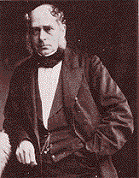
Henry Bessemer

Slide 6
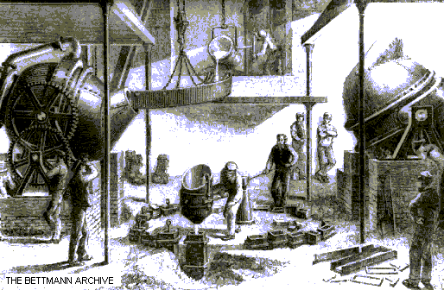
Bessemer steel

Slide 7
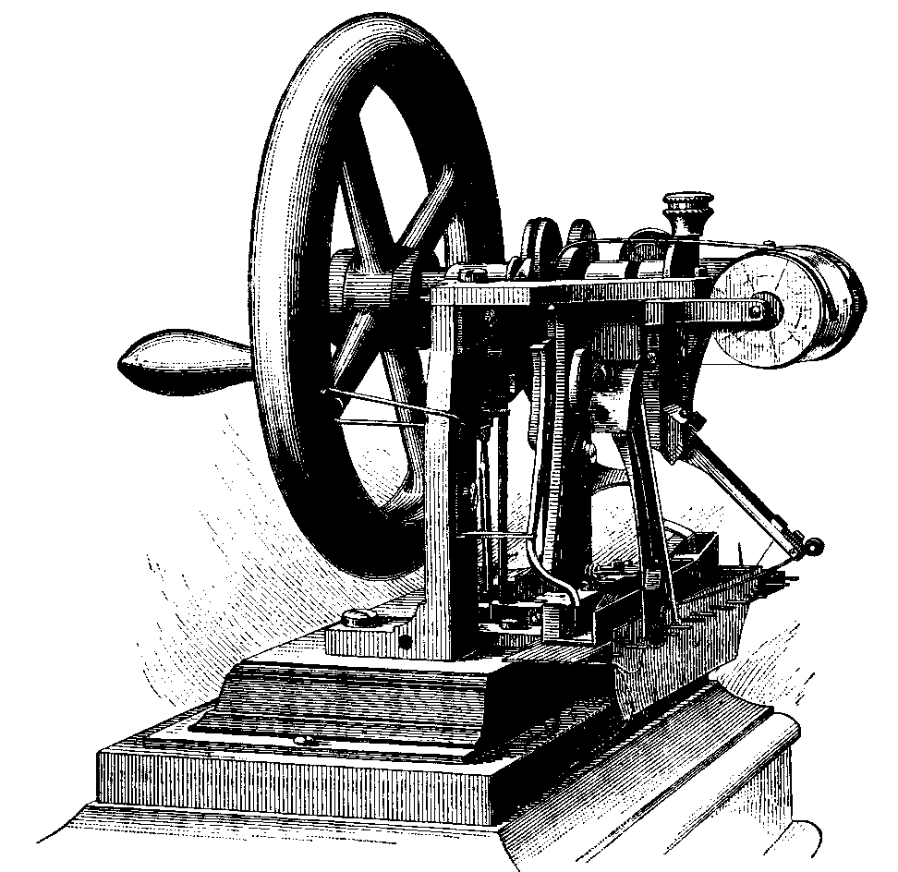

Slide 9
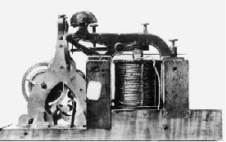
Telegraph

Slide 10
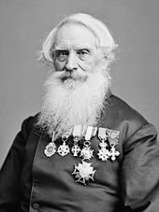
Samuel Morse

Slide 11
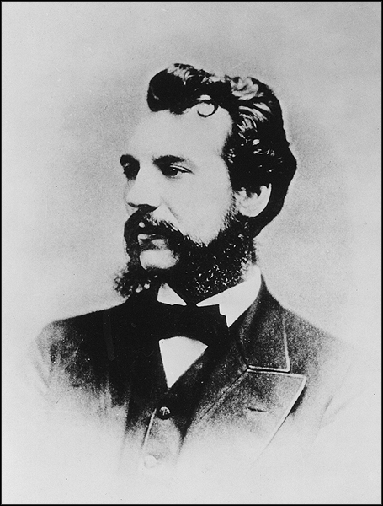
Alexander Graham Bell

Slide 12
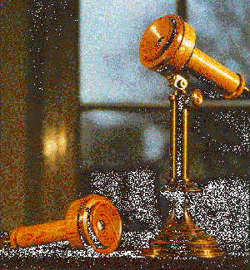

Slide 13
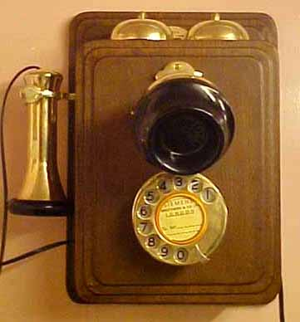

Slide 14
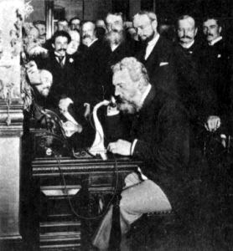

Slide 15
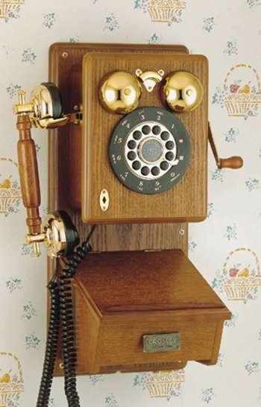

Slide 16
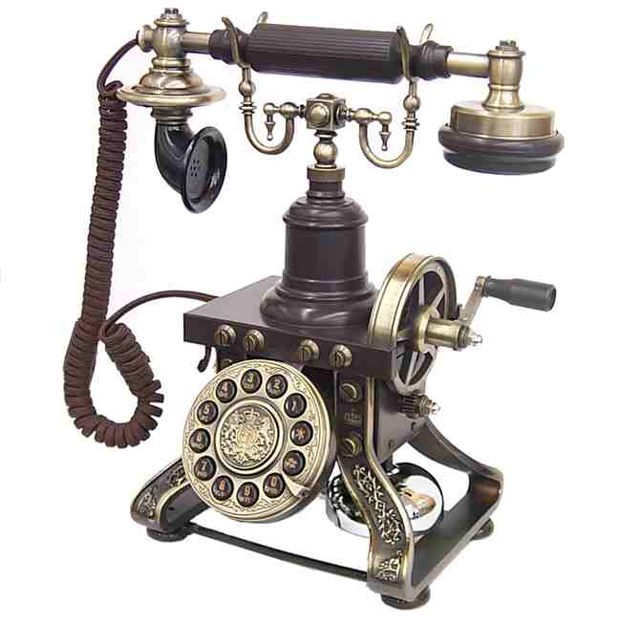

Slide 17
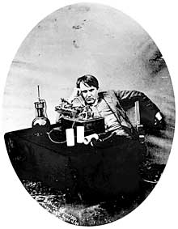

Slide 18
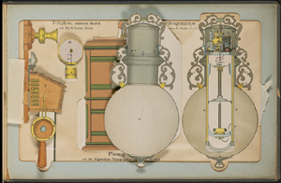

Slide 19
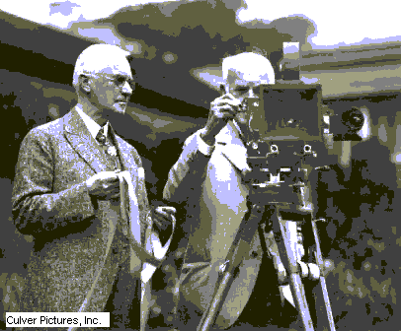
Thomas Edison

Slide 20
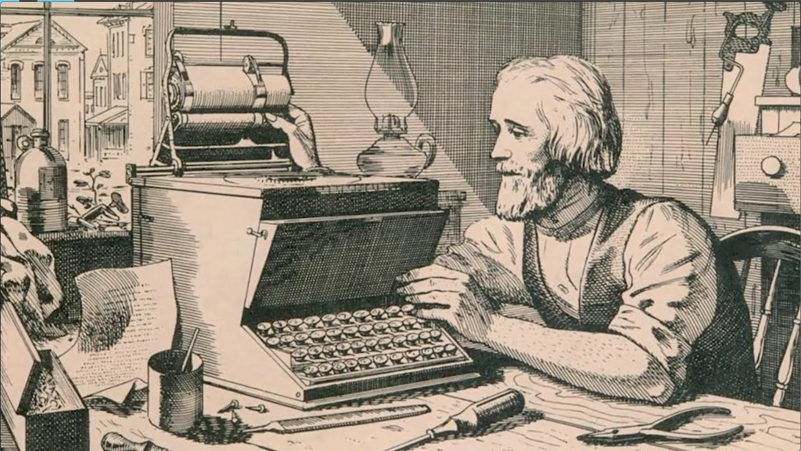

Slide 21
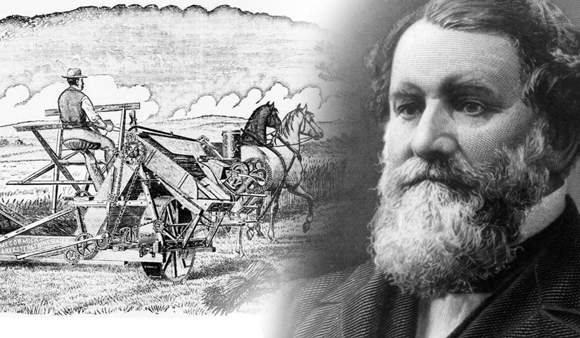

Slide 22
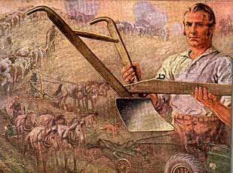

Slide 23
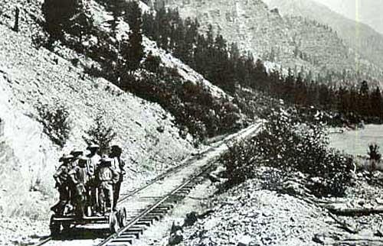

Slide 24
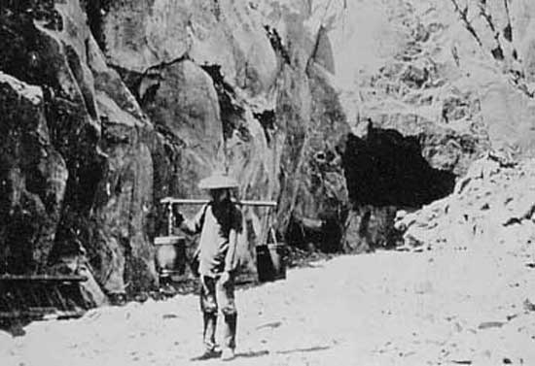

Slide 25
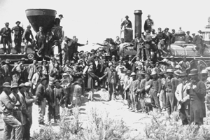

Slide 26
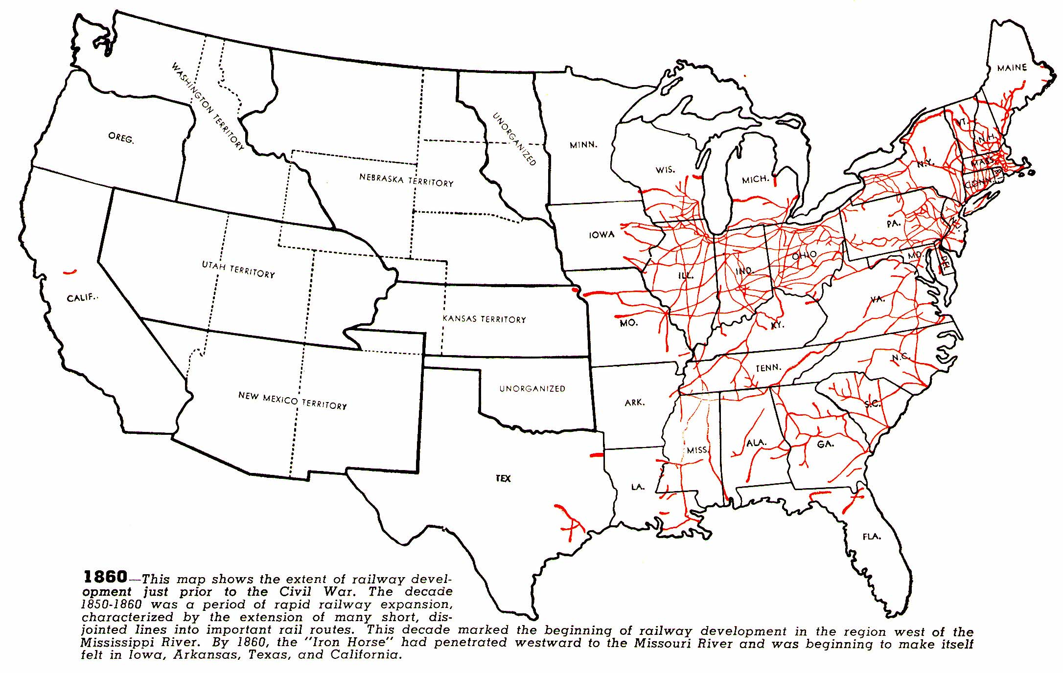

Slide 27
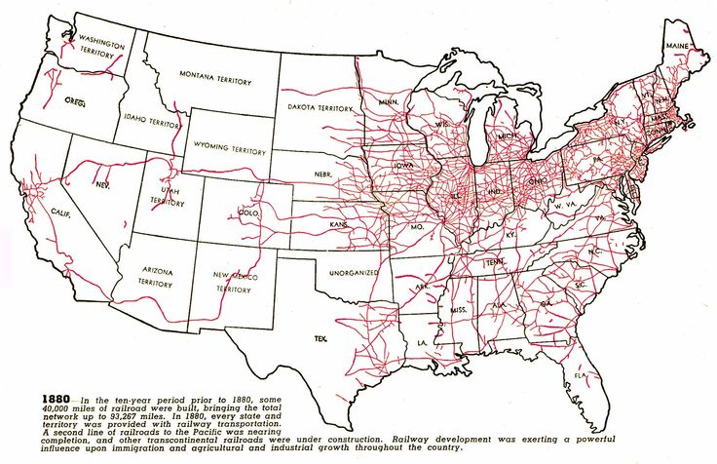

Slide 28
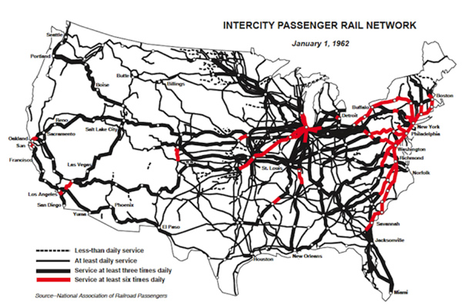

Slide 29
Philosophy of Wealth
Extremely wealthy v. the extremely poor
Should the wealthy share?
Is it the fault of the poor that they are poor?
Gospel of Wealth v. Social Darwinism

Slide 30
Social Darwinism
Coined by Herbert Spencer:
“Survival of the fittest.”
The unfit lose to the fit
Winners make up a natural upper class
Rich are rich because they are better than the poor.

Slide 31
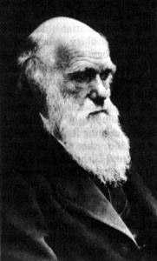
Charles Darwin

Slide 32
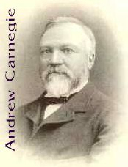

Slide 33
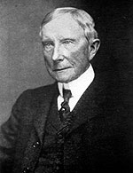
John D. Rockefeller

Slide 34
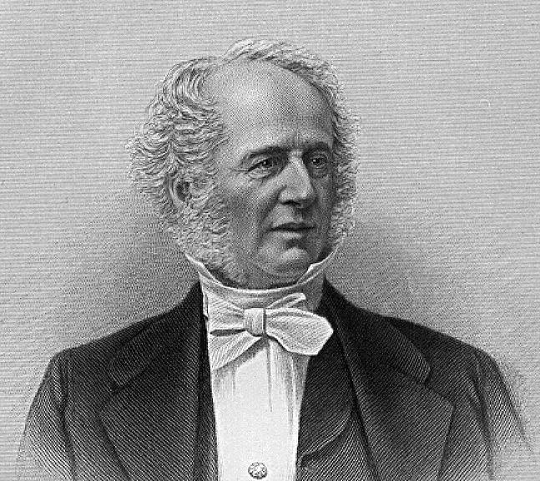
Cornelius Vanderbilt

Slide 35
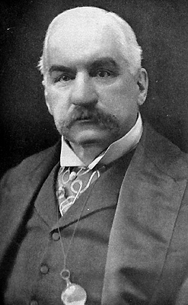
J.P. Morgan

Slide 36
Work Conditions
10-12 hr. workday
6 days/wk for $2-$3/day
Extremely dangerous
Sweatshops: Garment Industry
Child Labor

Slide 37
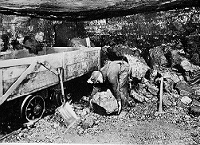

Slide 38
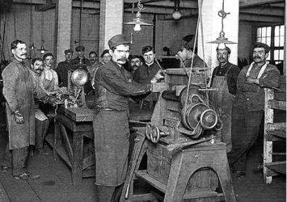

Slide 39
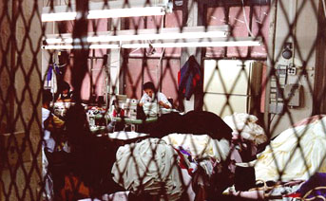

Slide 40
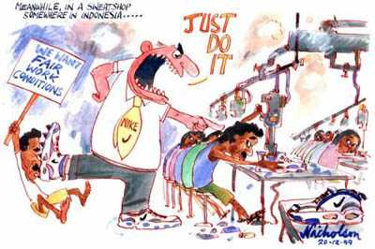

Slide 41
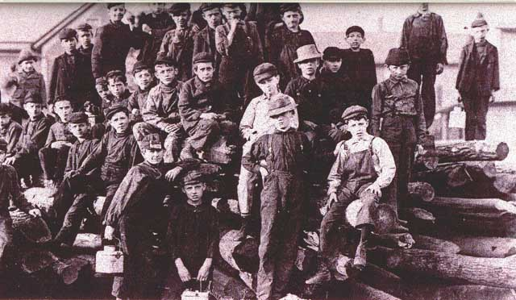

Slide 42
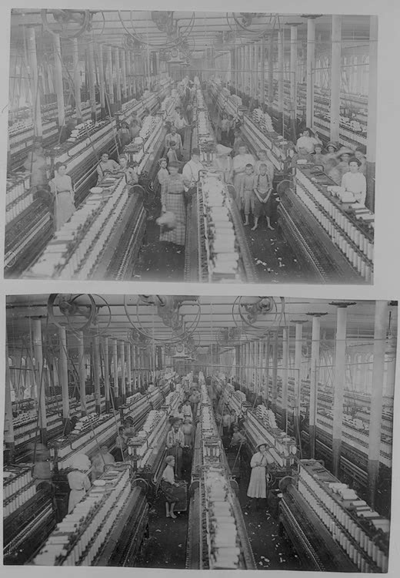

Slide 43
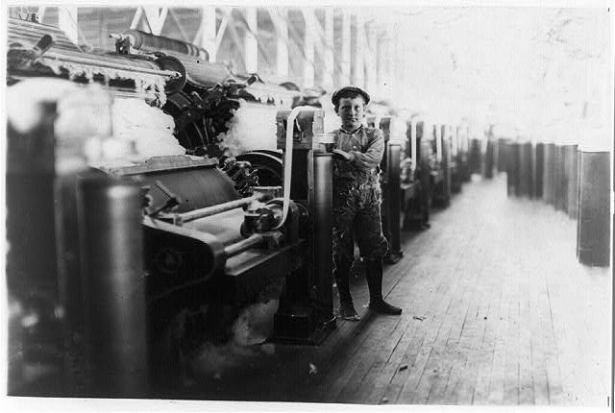

Slide 44
Labor Unions
Created to protect the rights of workers in certain industries
Working conditions, pay, hours, etc…
Originally for skilled craftsman, eventually becomes open to all
Owners refused to recognize them
Numerous violent encounters during strikes
Not truly successful until the AFL begins using Collective Bargaining to get concessions from the owners.

