Slide 1
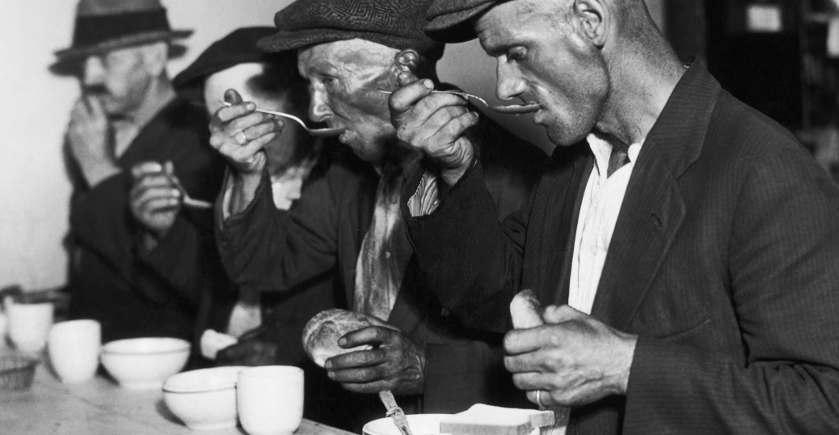
The Great Depression

Slide 2
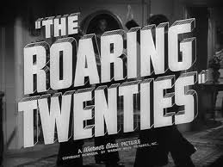
Issues before the Depression
Causes:
Began after the stock market crash of October 1929, Wall Street was sent into a panic and millions of investors were wiped out
Consumer spending and investment dropped over the next several years
There were steep declines in industrial output and employment as failing companies laid off workers
“The Roaring Twenties” was when the U.S. economy expanded rapidly and the nation’s total wealth more than doubled between 1920 and 1929
The stock market centered in New York City underwent rapid expansion and reached its peak in August 1929
Notes:
Briana

Slide 3
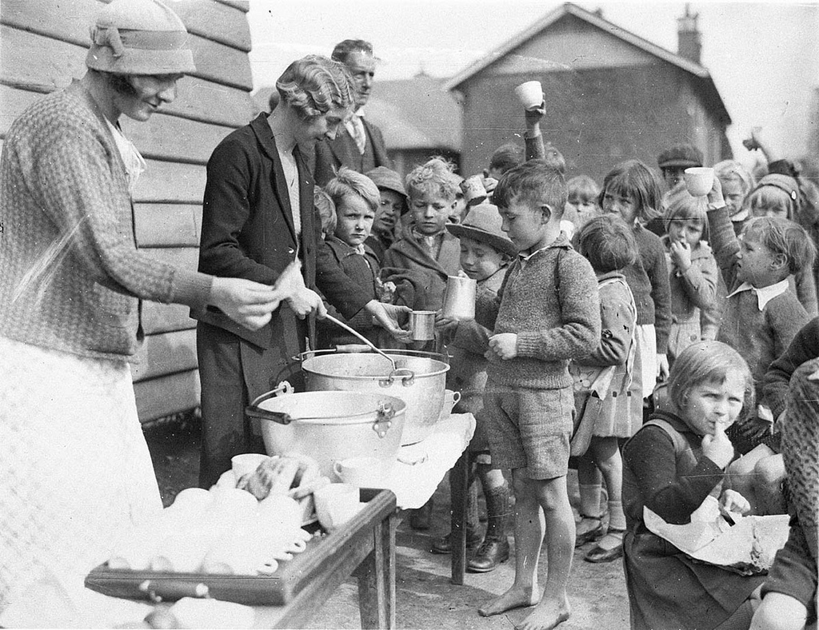
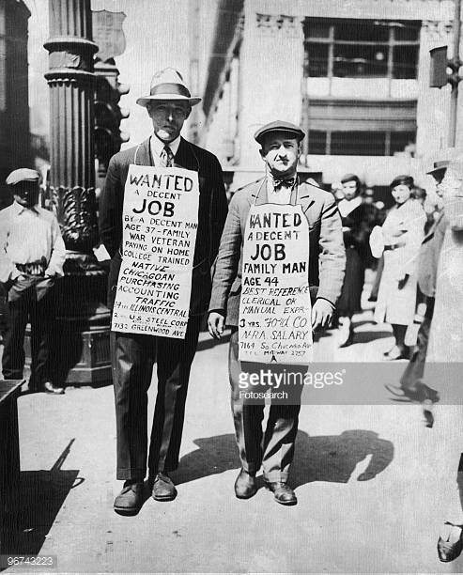
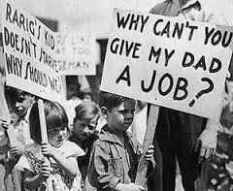
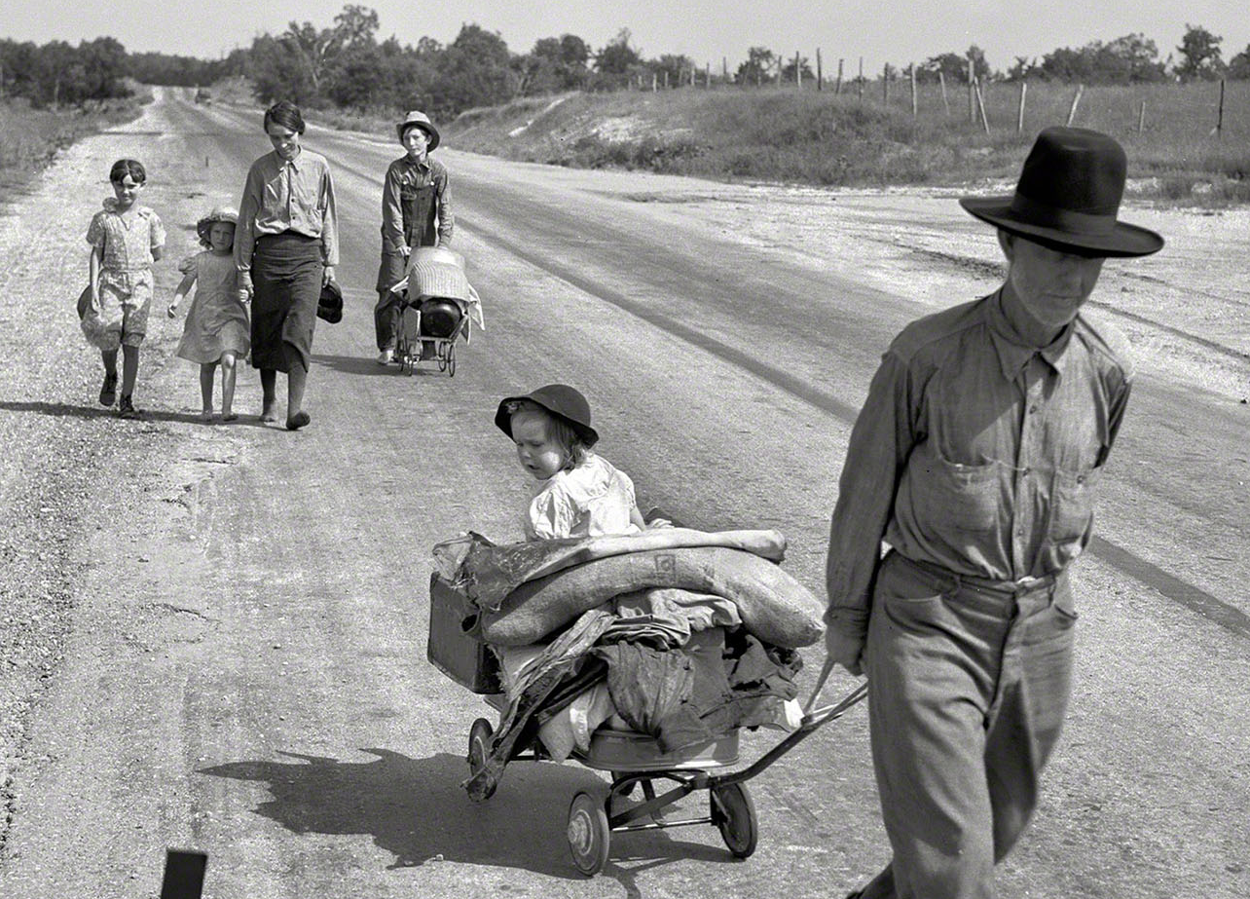
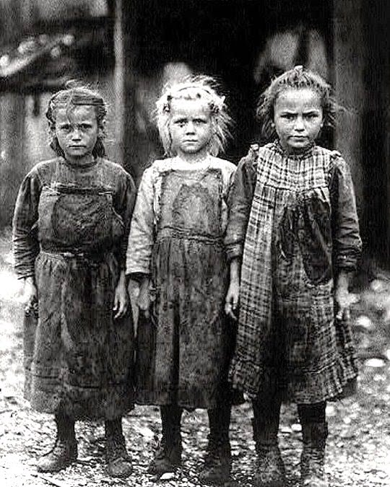
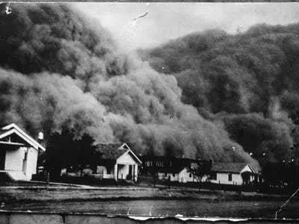
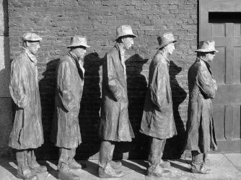
The Great Depression
Lasted from 1929-1939
Biggest downturn in American history
Starvation/hunger
Poverty/homelessness
Unemployment
Illness/suicides
Businesses close
The story of how individual families endured and survived, whether battling the despair of hunger and unemployment in the city or the fear of unending drought and forced migration.
Notes:
Ireland

Slide 4
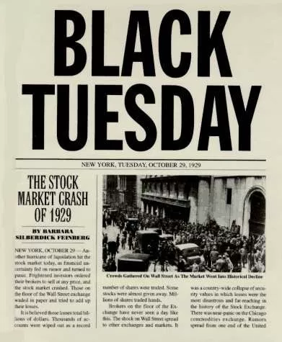
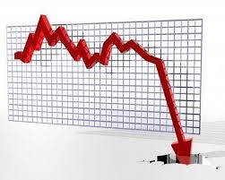
The Stock Market Crash
The stock market crash occurred on October 24, 1929
Investors began selling overpriced shares, about 12.9 million shares were traded that day on “Black Thursday”
On October 29, “Black Tuesday” 16 million shares were traded after another wave of panic swept Wall Street
Millions of shares ended up worthless and the investors who bought stocks with borrowed money were completely wiped out
The downturn in spending and investment led factories and other businesses to slow down production and fire their workers
Wages fell and buying power decreased
Many Americans forced to buy on credit fell into debt and the number of foreclosures and repossessions climbed steadily
Notes:
Briana

Slide 5
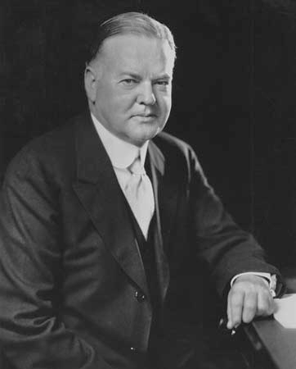
President Herbert Hoover
Sworn into office: March 4, 1929
Gross National Product (GNP) was at a high of $200 billion + stock market was soaring
Voiced optimism of a thriving nation through expanding
Increase support of education, public health,
Better law enforcement
A model of hard-work, efficiency and dedication to Americans
Beliefs:
Government should boost business, or bolster industries
Create jobs
Increase profits that would help economy
Giving Federal Government power to regulate free enterprise was threatening America’s foundation
Do not give money to the homeless or unemployed directly
Notes:
Ireland

Slide 6
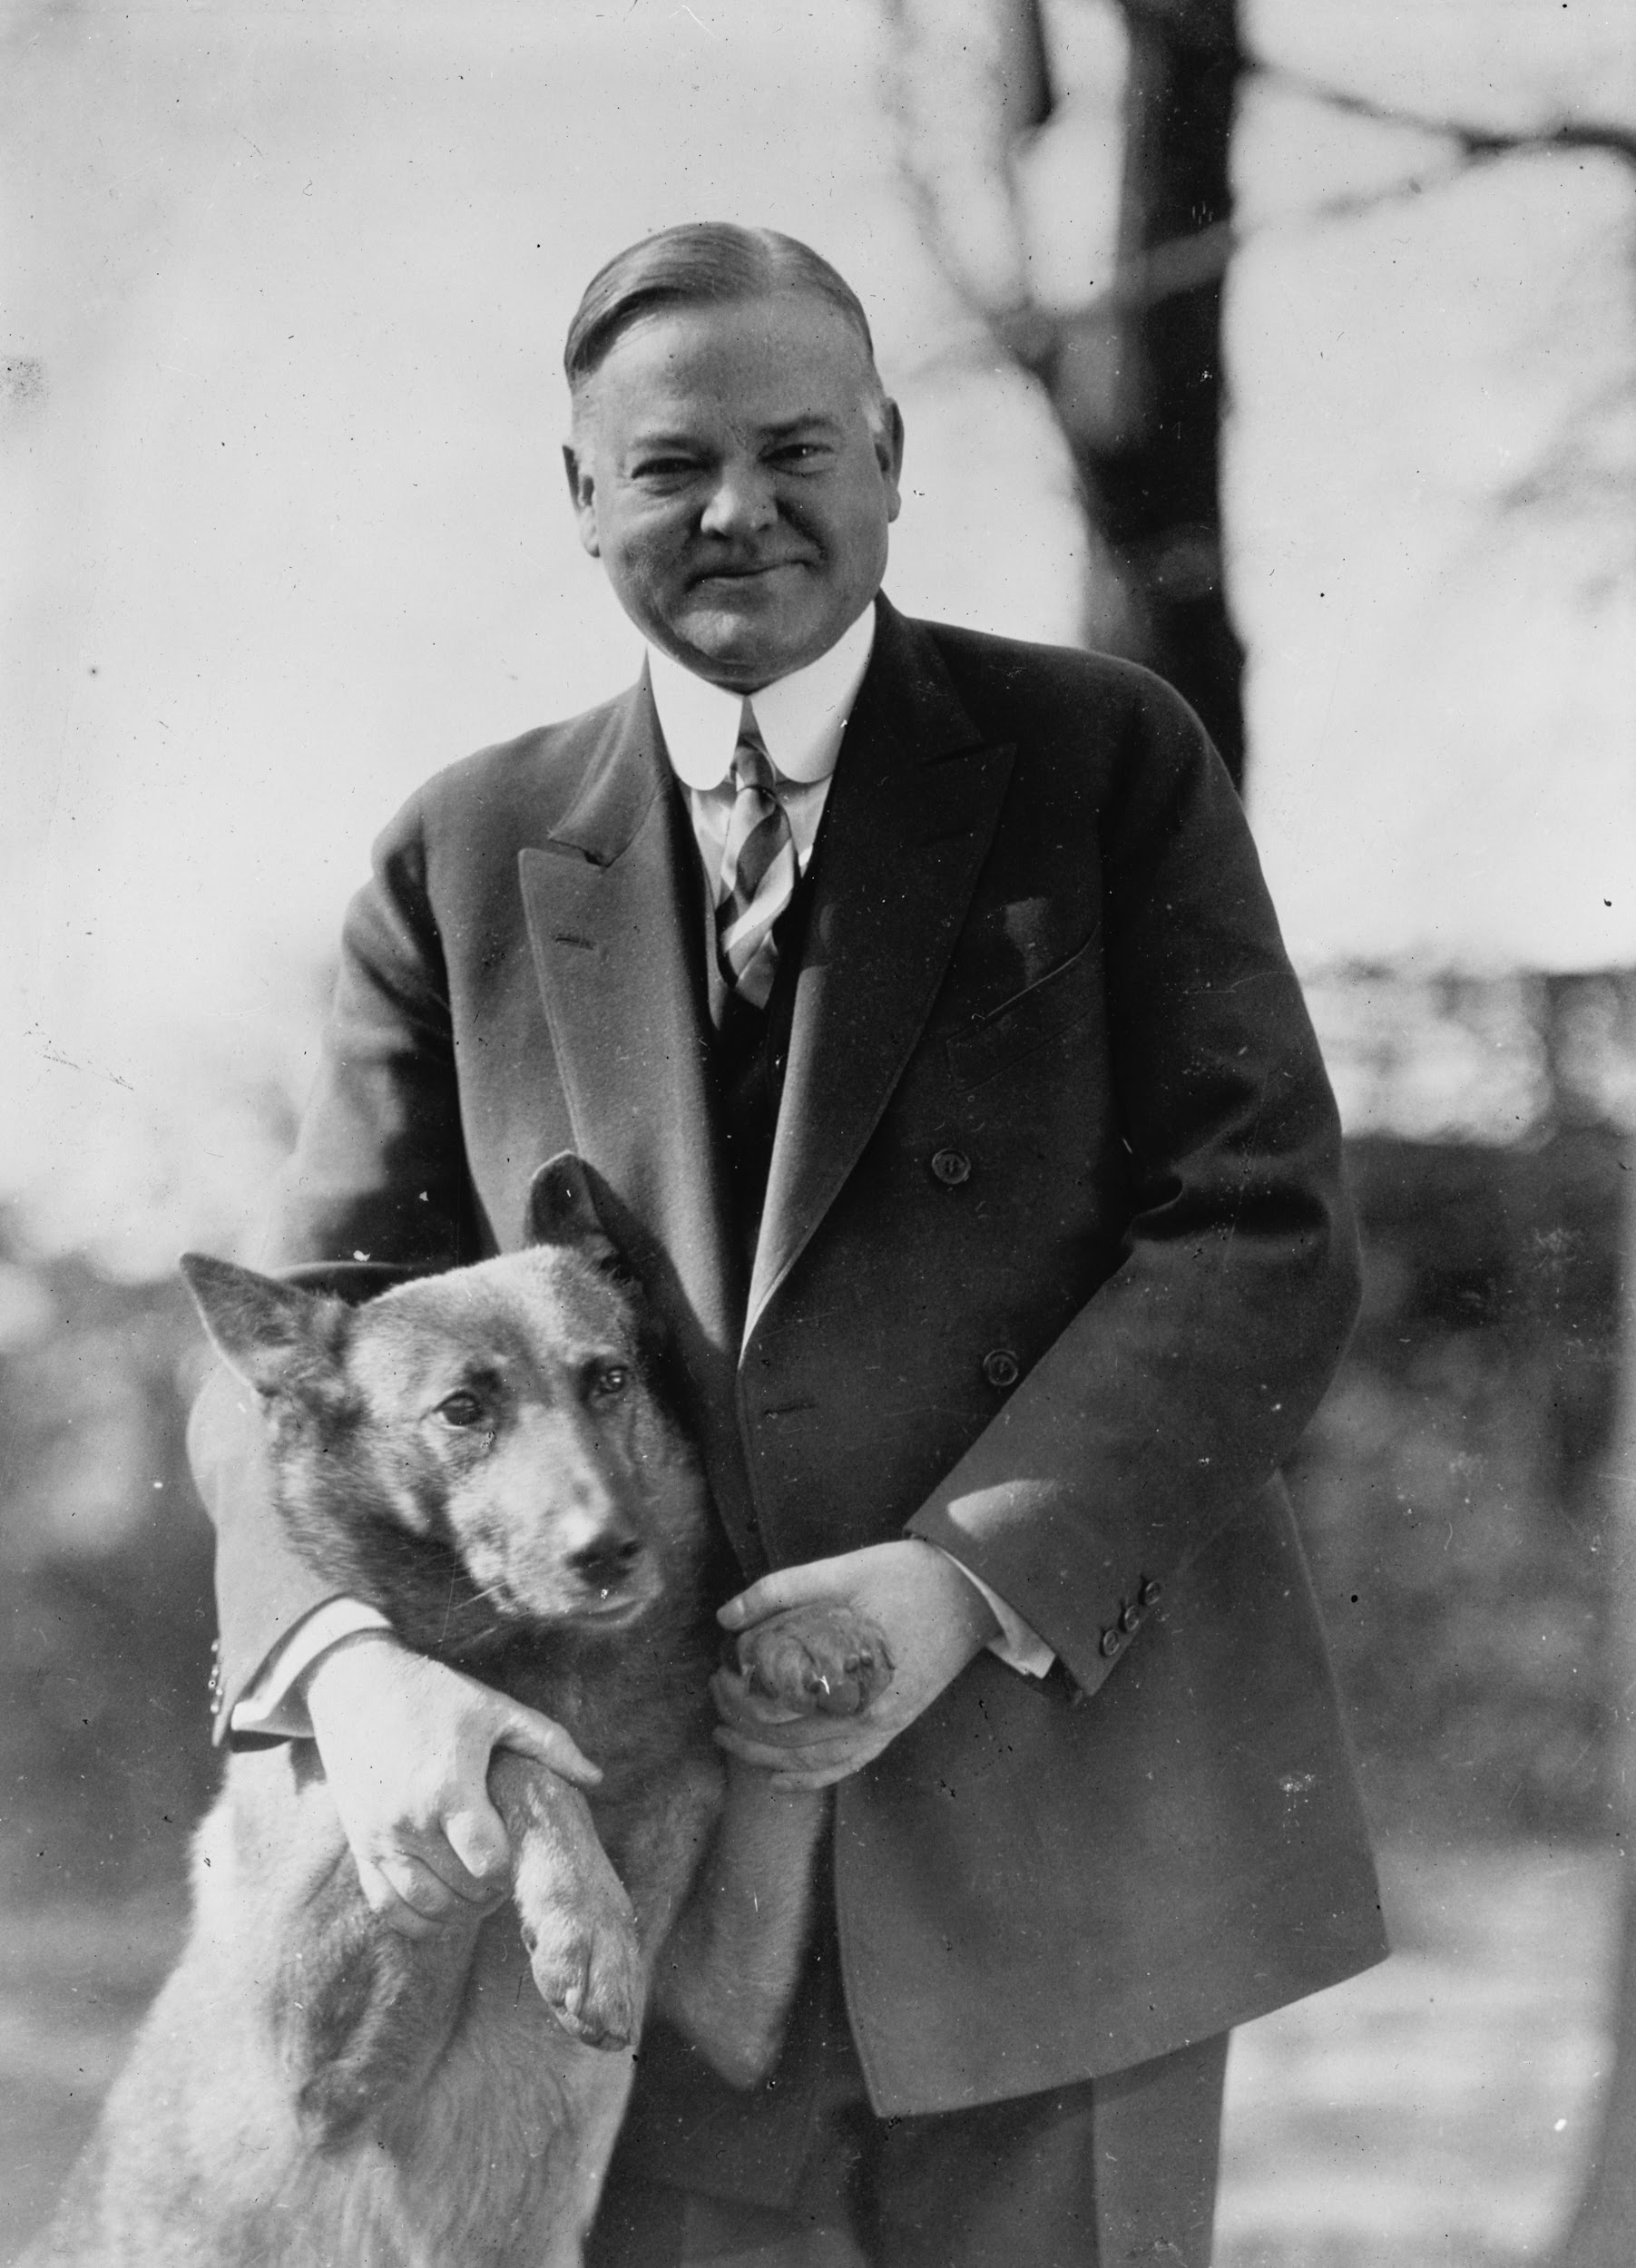
Hoover (continued…)
Plan of Action:
Reconstruction Finance Corporation (RFC): empowered to lend $2 billion to banks, railroads, buildings, insurance companies, and loan associations
Hoover Dam construction
Create jobs + energize building industry
Urged the Federal Farm Board to buy large quantity of crops in hopes of helping farmers
Bonus Army: turned public against him
Unemployed WW1 veterans march to Washington
Demand for war bonuses that Congress promised
Hoover calls police to evacuate veterans
Notes:
Ireland

Slide 7
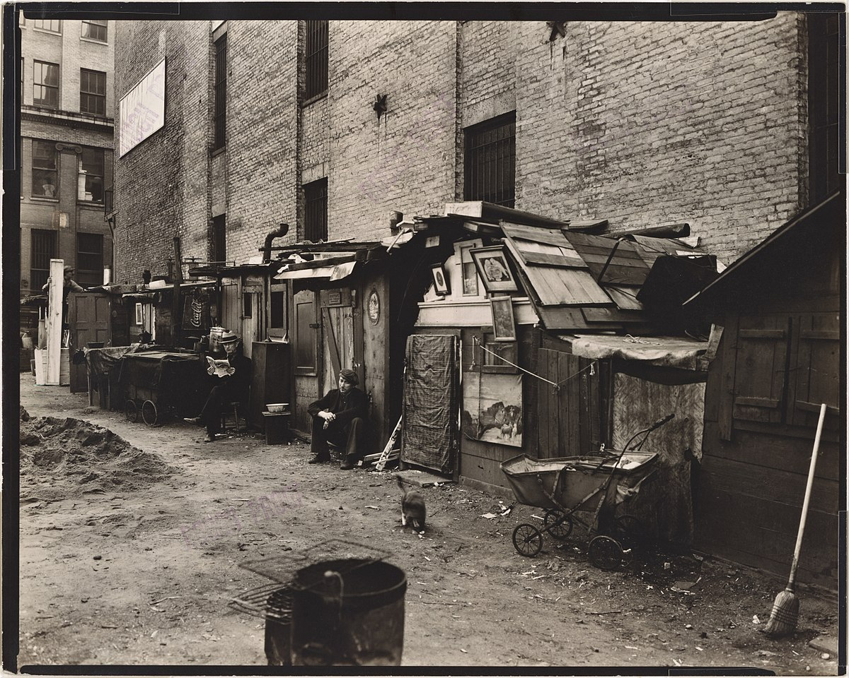
(continued…)
His name was being linked to the depressions hardships
“Hoovervilles”
“Hoover blankets” (newspapers)
Conjures images of breadlines, soup kitchens…
“Hoover depression”

Slide 8
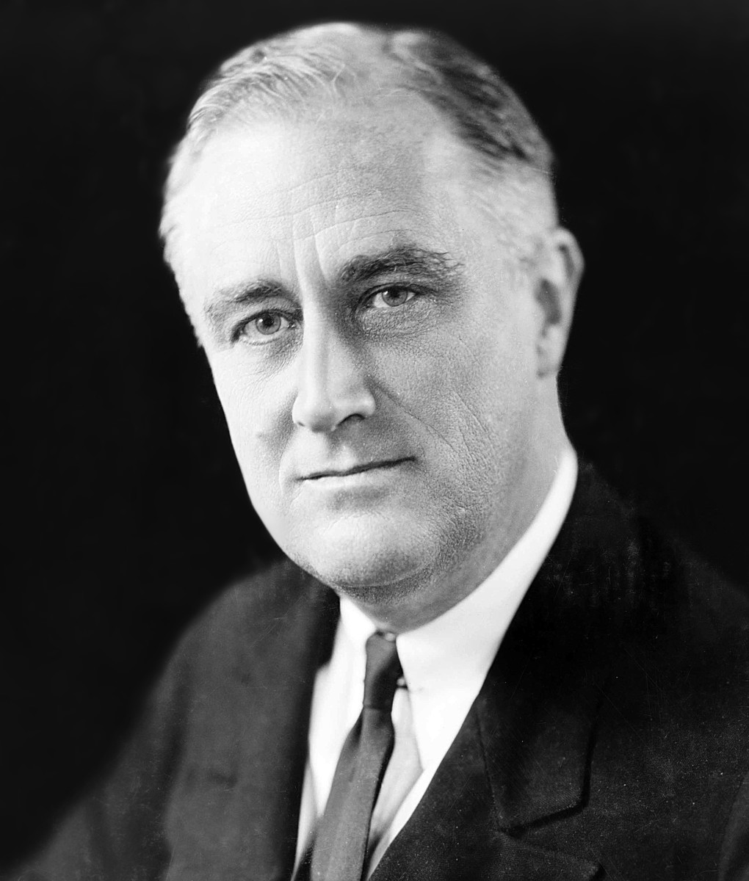
President Roosevelt
Franklin Delano Roosevelt (FDR) led the nation through the Great Depression
He was elected to the presidency 4 times, serving as the nation’s 32nd president from March 1933 until his death in office in April 1945
His New Deal expanded the role of the federal government in the nation’s economy to address the challenges of the Great Depression
Roosevelt asserted that he would help “the forgotten man at the bottom of the economic pyramid”
On March 12, 1933 Roosevelt delivered “fireside chats” the first of his live-radio
He delivered 30 “fireside chats” during his presidency and explained to the public his New Deal policies and the Second World War
President Roosevelt sought to pack the US Supreme Court which called for adding an additional justice to the Court for every justice over the age of 70
Notes:
Briana

Slide 9
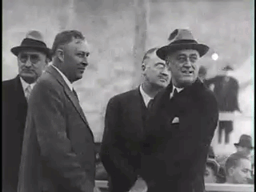
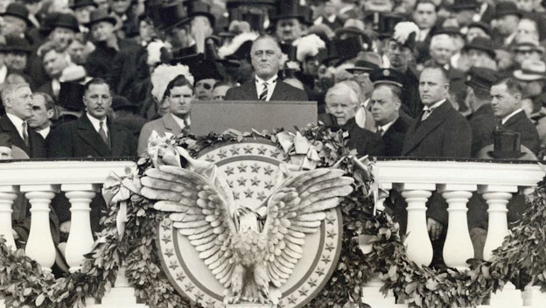
The New Deal
Promise of a New Deal: Inauguration Speech
“I pledge you, I pledge myself, to a New Deal for the American People”
Assured Americans that their nation would be revived and it would prosper
Stressed the need for immediate action as if it was a war
Relief, Recovery, and Reform:
1. Relief - Immediate action taken to halt the economies deterioration.
2. Recovery- Temporary programs to restart the flow of consumer demand “First Hundred Days”
3. Reform - Permanent programs to avoid another depression and insure citizens against economic disasters.
Notes:
Ireland

Slide 10
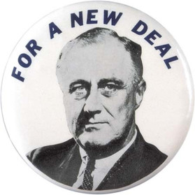
First New Deal
Emergency Banking Act
Treasury Department has power to decide which banks open and which ones close for good
Tennessee valley Act
Enabled the Federal Government to build dams along the river to control flooding and generate cheaper power
Industrial Recovery Act
Guaranteed workers the right to unionize and bargain for higher wages + better working conditions
Agricultural Adjustment Act
designed to boost agricultural prices by reducing surpluses
Glass-Steagall Act
Offered protection to people who entrust their savings to commercial bank
Home Owners Loan Act
help those in danger of losing their homes

Slide 11
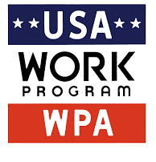
The Second New Deal
WPA (Works Progress Administration)
Created jobs by improving highways, dredging rivers and harbors, and providing programs in the arts to unemployed artists
SSA (Social Security Act)
Gave financial aid to those who were retired, unemployed, disabled, widowed, or injured on the job
REA (Rural Electrification Administration)
Loaned money to electric utility companies to supply power to rural areas
NLR (National Labor Relations/Wagner Act)
Outlawed unfair labor practices and gave workers the right to organize unions
Fair Labor Standards Act
Banned child labor, created a minimum wage, and limited workweeks to 44 hours.
Food Drug Cosmetic Act
Prohibited the mislabeling of food, drugs, and cosmetics

Slide 12
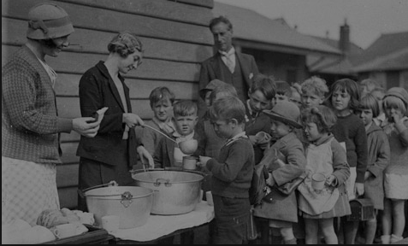
Life/Unemployment Rates
Unemployment reached an all-time high when heavy industries such as construction came to a grinding halt and farming was hit by deflated crop prices
Unemployment worsened with the non availability of jobs and a dependency on primary sector industries
People turned to farming and mining as sources of livelihood alongside the Wall Street Crash
Major causes of unemployment were the complete collapse of the stock market worldwide, cut-back business and government expenditures, few alternate job resources, low credit availability, deflation in prices of consumer goods, drought conditions, and increase in retaliatory tariffs
The effects of unemployment were that businesses shut down and left people jobless
Reduction in output and trade made the employment opportunity bleak
Notes:
Briana

Slide 13
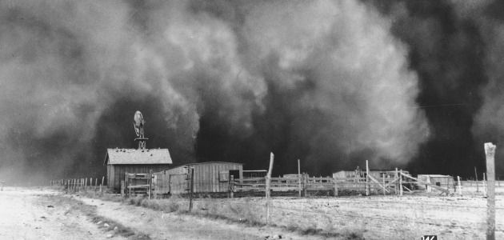
The Dust Bowl
Years of over planting and plowing robbed the topsoil of nutrients and made it harder for the soil to hold in moisture
Land became dry, winds picked up, and dust storms began to occur spreading topsoil across southern plains
Struggles:
Difficult to see
Hard to breathe, suffocation
Cattle and other farm animals sickened and died except grasshoppers & jackrabbits
Many crops ruined, farm prices rise
Could not use anything until it was washed
Notes:
Ireland

Slide 14
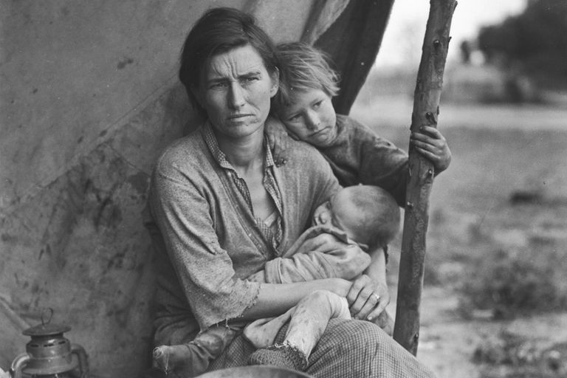
Migration
Heading to California (Highway 66)
Escape the despair of the Dust Bowl
Road to opportunities
Civilian Conservation Corps
relieve unemployment by providing national conservation work primarily for young unmarried men
Works Progress Administration
purpose of the program was to provide useful work for those effected and thus to preserve their skills and self-respect
Notes:
Ireland

Slide 15
How successful was the New Deal?
Roosevelt promised and delivered what he said he would: “action and action now”
Created programs that improved many lives during the hard time
Eliminated Financial practices that started the depression
Neutrality Legislation created
Prohibited trade and credit to any country in war during WW2
Notes:
Ireland

Slide 16
How does the Great Depression affect us today?
America expanded government intervention into new areas of social and economic affairs
Creation of more social assistance agencies
The government took on greater roles on the everyday social and economic lives of people
FDR created a liberal political alliance that was made up of labor unions, blacks, poor and farmers
The groups that were in an alliance ended up being the Democratic that we have today
Led to the programs of JFK’s frontiers and war of poverty
Taught the U.S. how to avoid having another economic downfall
Notes:
Briana

Slide 17
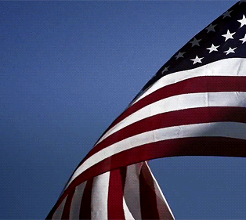
Works Cited
Press, Petra. Through the Decades The 1930's. Lucent Books, 1999. A Cultural History of the United States
"Great Depression: Causes & Effects." HISTORY.com, www.history.com/topics/great-depression.
"New Deal | Programs and Definition." HISTORY.com, www.history.com/topics/new-deal.

Slide 18
Works Cited (Continued)
"FDR and the Great Depression." Khan Academy, www.khanacademy.org/humanities/us-history/rise-to-world-power/great-depression/a/franklin-delano-roosevelt-as-president.
"Great Depression: Causes & Effects." HISTORY.com, www.history.com/topics/great-depression.
"How Does the Great Depression Affect Us Today?" Home Page, reshapingthenations.weebly.com/how-does-the-great-depression-affect-us-today.html.
"Unemployment During the Great Depression." Historyplex, historyplex.com/unemployment-during-great-depression

