Slide 1
Indirect Causes of
European Explorations

Slide 2
Why begin exploring?
What led Europeans to look for a new route to Asia?
Economics
Politics
Religion

Slide 3
Motives for European Exploration
Crusades → by-pass intermediaries to get to Asia.
Renaissance → curiosity about other lands and peoples.
Reformation → refugees & missionaries.
Monarchs seeking new sources of revenue.
Technological advances.
Fame and fortune.

Slide 4
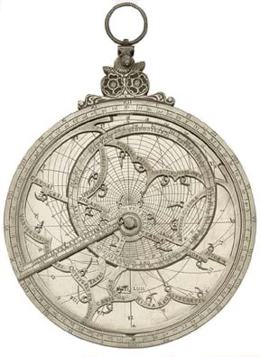
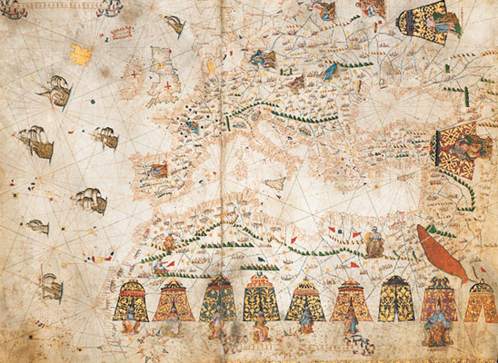
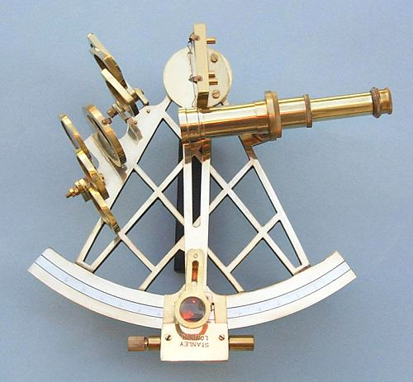
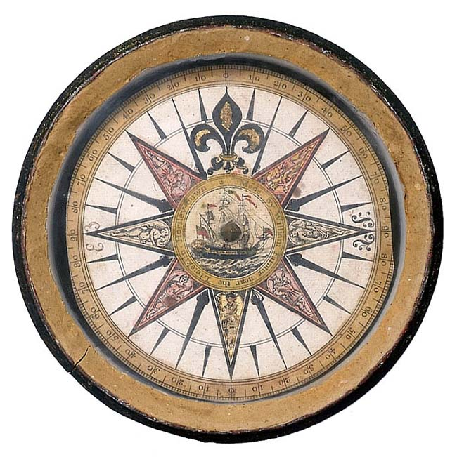
New Maritime Technologies
Better Maps [Portulan]
Hartman Astrolabe (1532)
Mariner’s Compass
Sextant

Slide 5
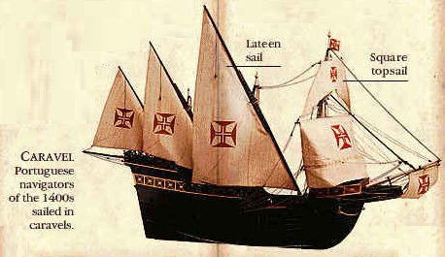
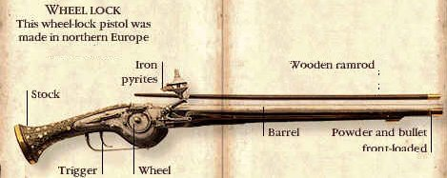
New Weapons Technology

Slide 6
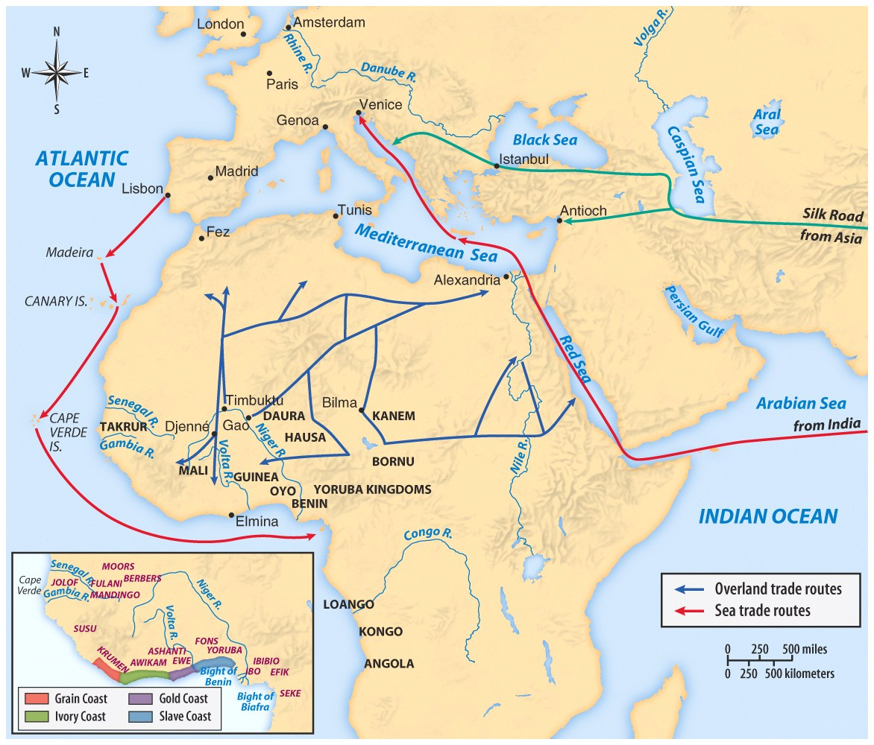
15th century trade routes

Slide 7
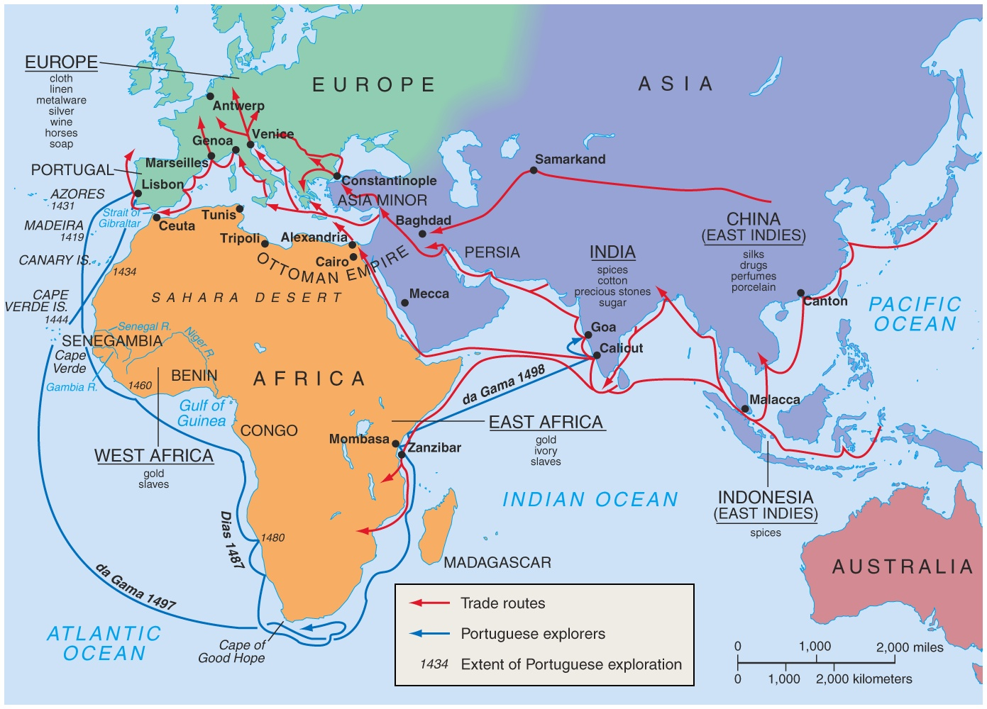
European trade routes

Slide 8
The Rebirth of Europe
Economy
Culture
Politics
Nations competed for Asian trade.
Ancient Greek, Roman,and Muslim art and learning were rediscovered.
Reformation: revolt against the Roman Catholic Church
Improved sea- faring technology aided exploration and trade.
Philosophy of humanism: use of reason and experimentation in learning
Government by nobles and the Church declined.
Spain & Portugal competed to explore trade routes.
Michelangelo, Leonardo da Vinci Shakespeare
The rise of nations

Slide 9
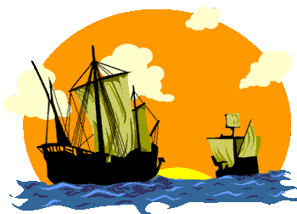
Direct Causes = 3 G’s
Political: Become a world power through gaining wealth and land. (GLORY)
Economic: Search for new trade routes with direct access to Asian/African luxury goods would enrich individuals and their nations (GOLD)
Religious: spread Christianity and weaken Middle Eastern Muslims. (GOD)
The 3 motives reinforce each other

Slide 10
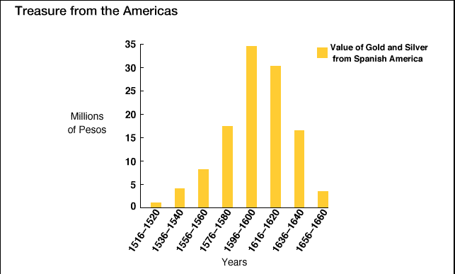
Treasures from the Americas!

Slide 11
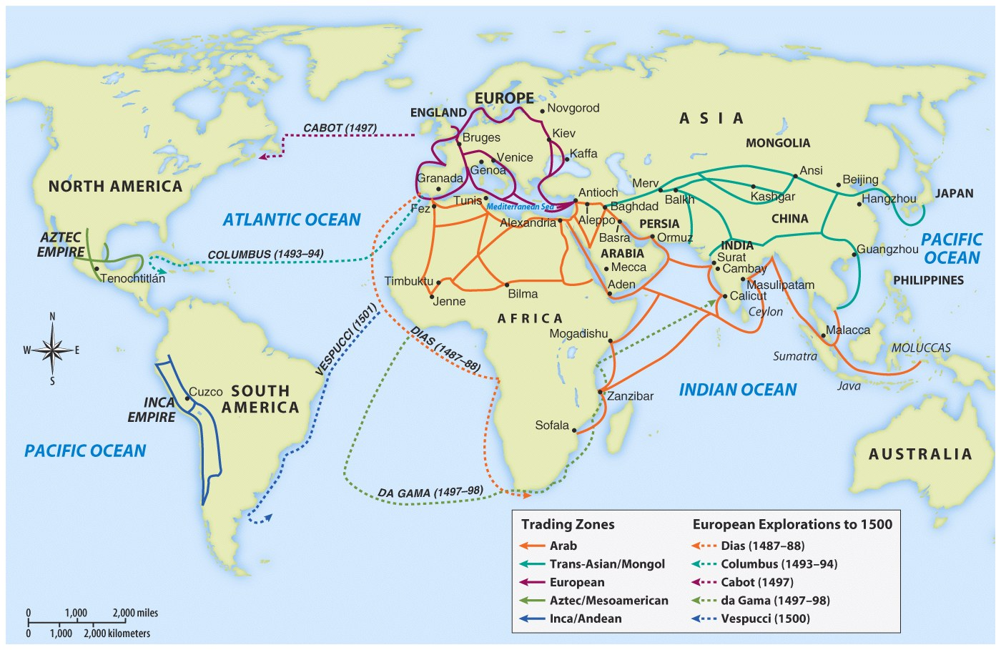

Slide 12
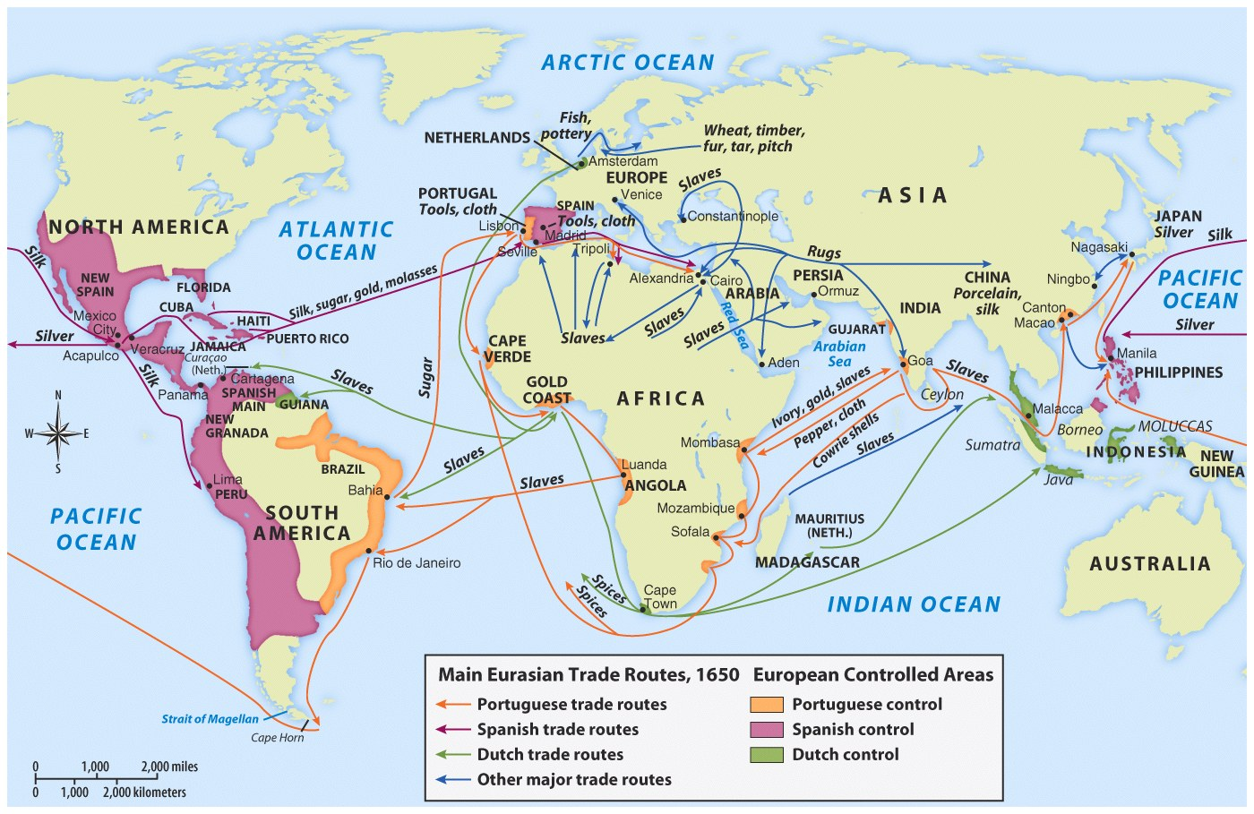

Slide 13
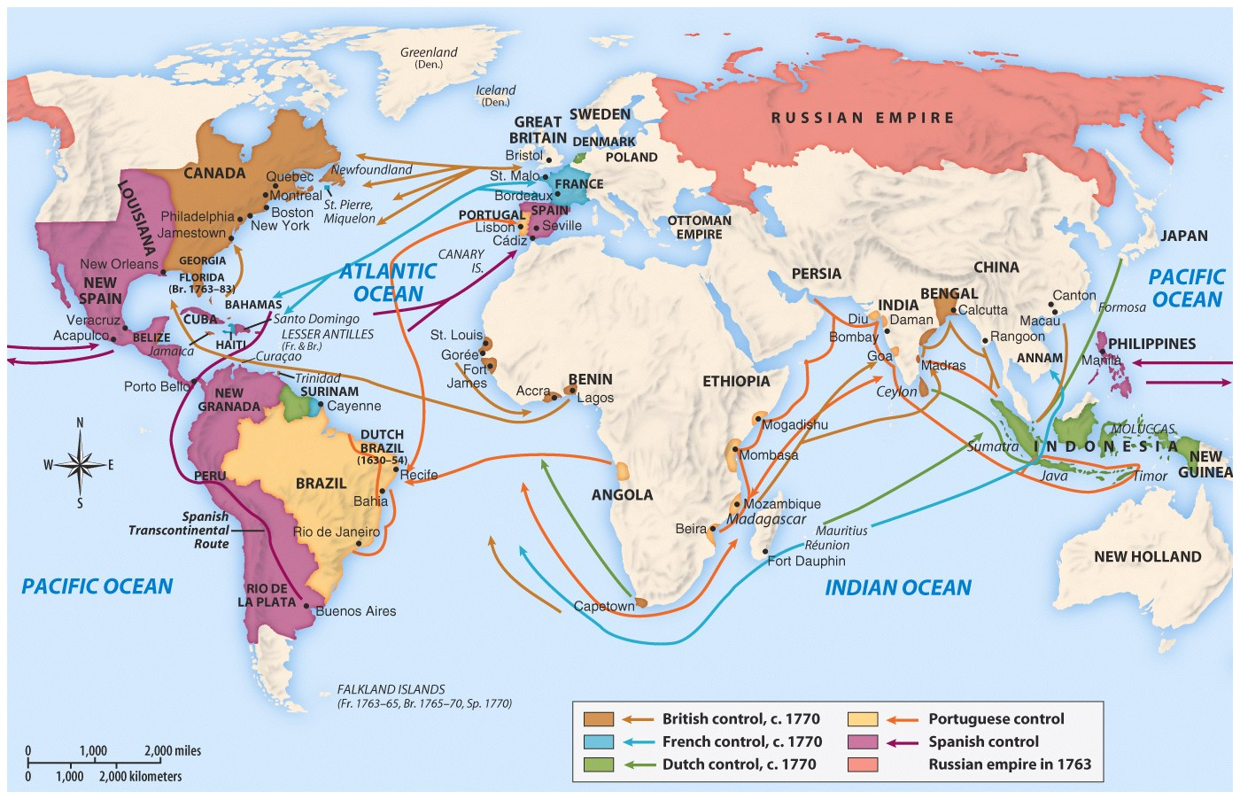

Slide 14
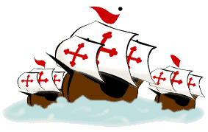
European explore
EUROPEAN EXPLORATION
1400 TO 1600
EFFECTS
Europeans reach and settle Americas
Expanded knowledge of world geography
Growth of trade, mercantilism and capitalism
Indian conflicts over land and impact of disease on Indian populations
Introduction of the institution of slavery
Columbian Exchange

Slide 15
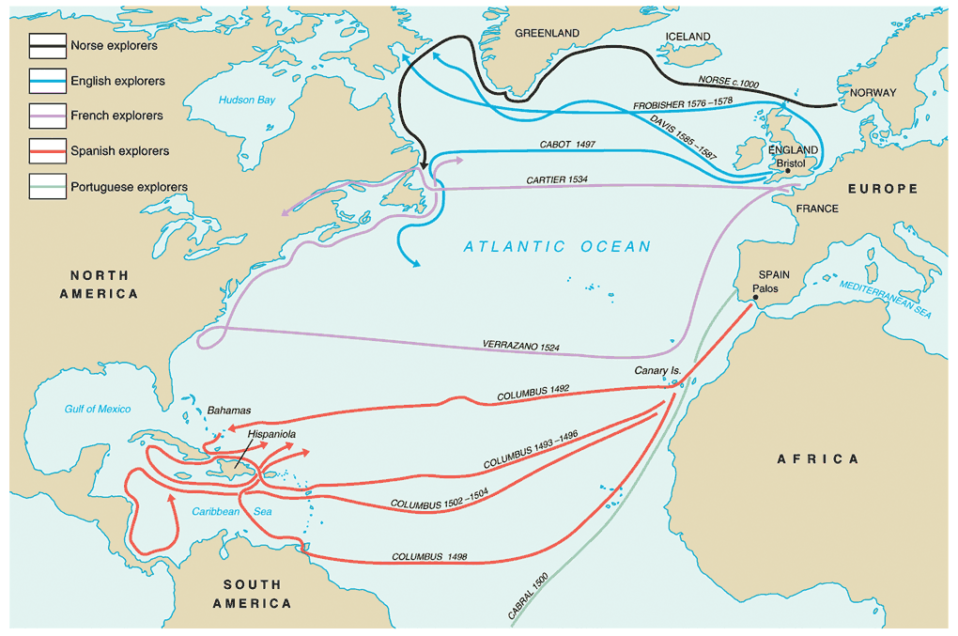

Slide 16
Effects of Exploration
What were the effects of exploration on European financiers?
What effect did it have on Natives?
On Africans?
On the poor in Europe? Or second and third sons?

Slide 17
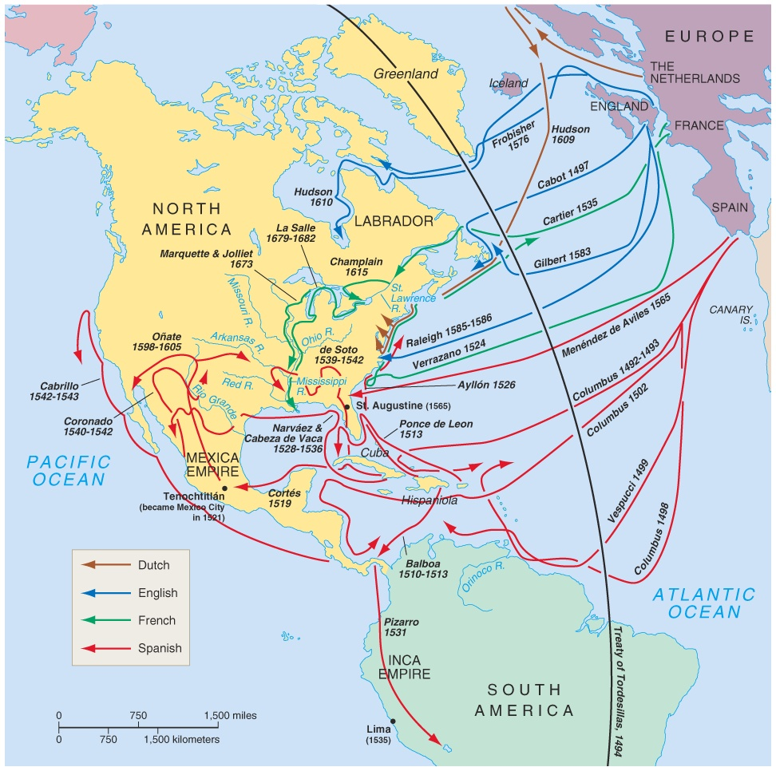
explorers

Slide 18
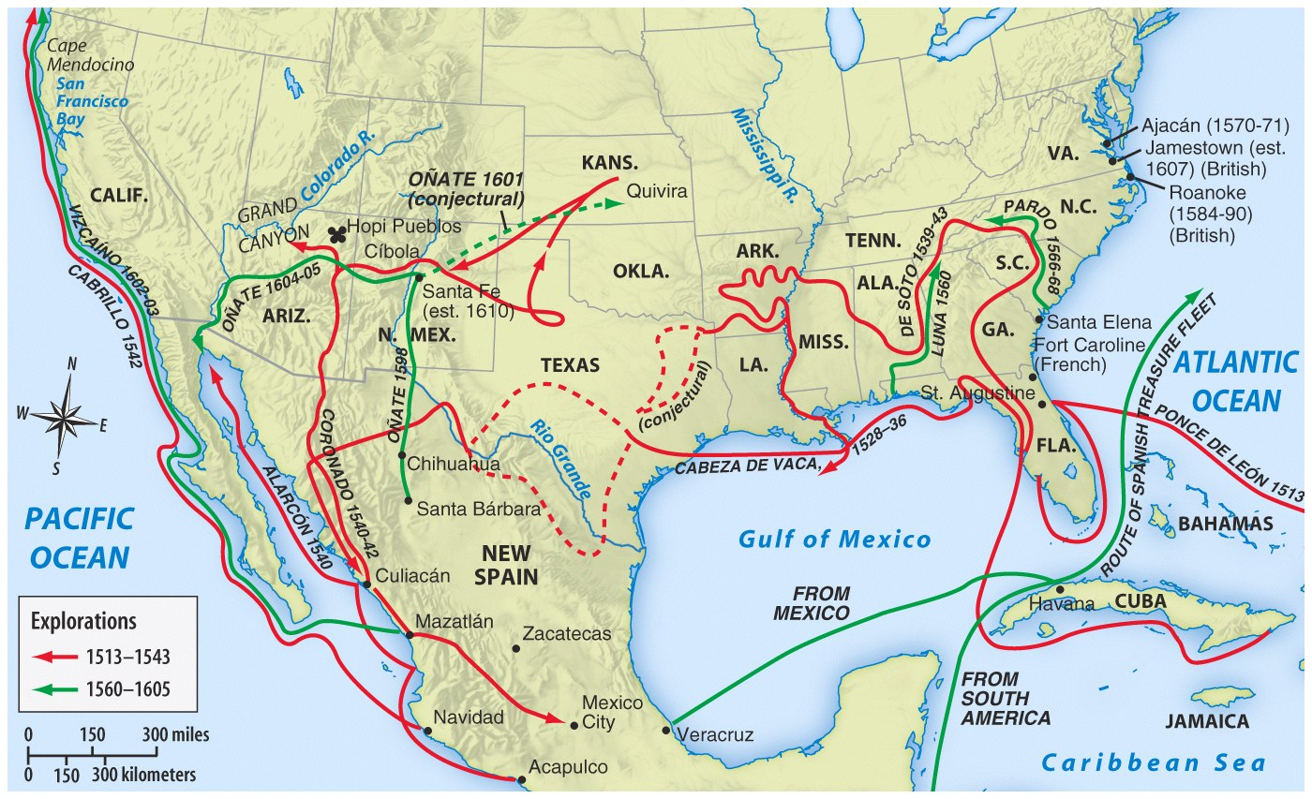

Slide 19
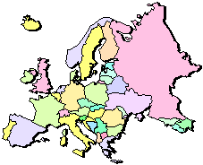
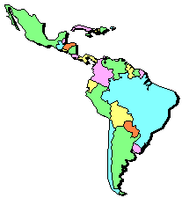
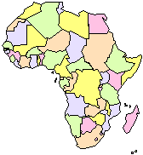
Columbian Exchange or the transfer of goods involved 3 continents, Americas, Europe and Africa
* Squash * Avocado * Peppers * Sweet Potatoes * Turkey * Pumpkin * Tobacco * Quinine * Cocoa * Pineapple * Cassava * POTATO * Peanut * Tomato * Vanilla * MAIZE * Syphillis
* Olive * Coffee Beans * Banana * Rice * Onion * Turnip * Honeybee * Barley * Grape * Peach * Sugar Cane * Oats * Citrus Fruits * Pear * Wheat * HORSE * Cattle * Sheep * Pig * Smallpox * Flu * Typhus * Measles * Malaria * Diptheria * Whooping Cough

Slide 20
European Colonization
European Colonization
Once the New World is discovered, the Big 4 four European countries begin competing for control of North America and the world….
Spain
England
France
Portugal
This power struggle ultimately leads to several wars.

Slide 21
Who wins?
What were the reasons for colonizing the New World by the big 4?
Which European power wins the colonial power struggle?
Who is the big loser?

Slide 22
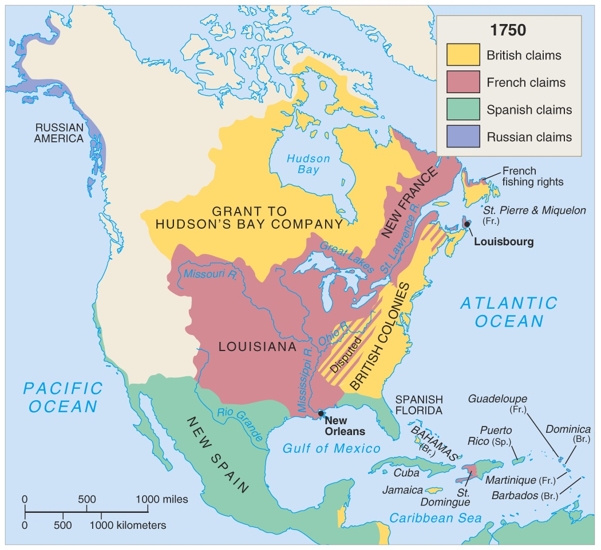
F/I War 1750

Slide 23
The
Spanish
Spanish first to pursue colonization
Start in Caribbean, then Central and South America—most important was conquest of Aztecs by Cortez (1521) and Incas by Pizzaro (1531)
First permanent colonies in what will become United States are founded by Spain
St. Augustine (Florida) is founded (1565) to protect Spanish treasure fleets

Slide 24
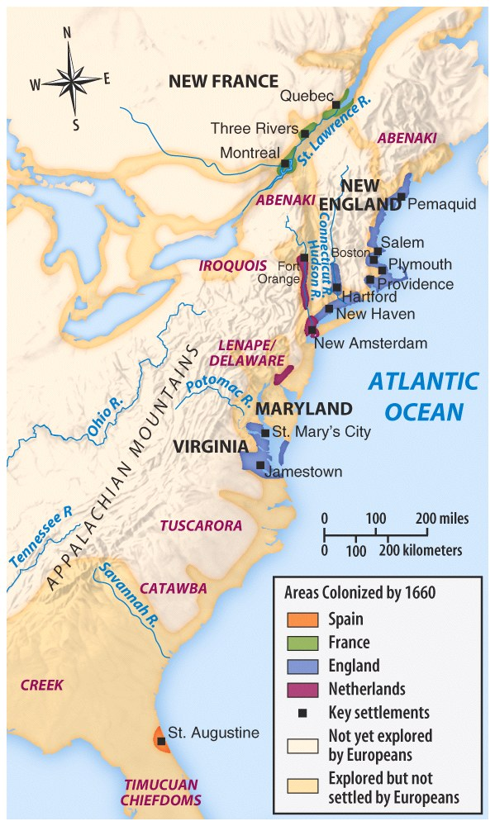

Slide 25
Explorers Sailing For Spain
Columbus - Italian sailing for Spain - Landed in the “West Indies” - 1492
Magellan - Portuguese sailing for Spain - 1st to circumnavigate the world - 1522

Slide 26
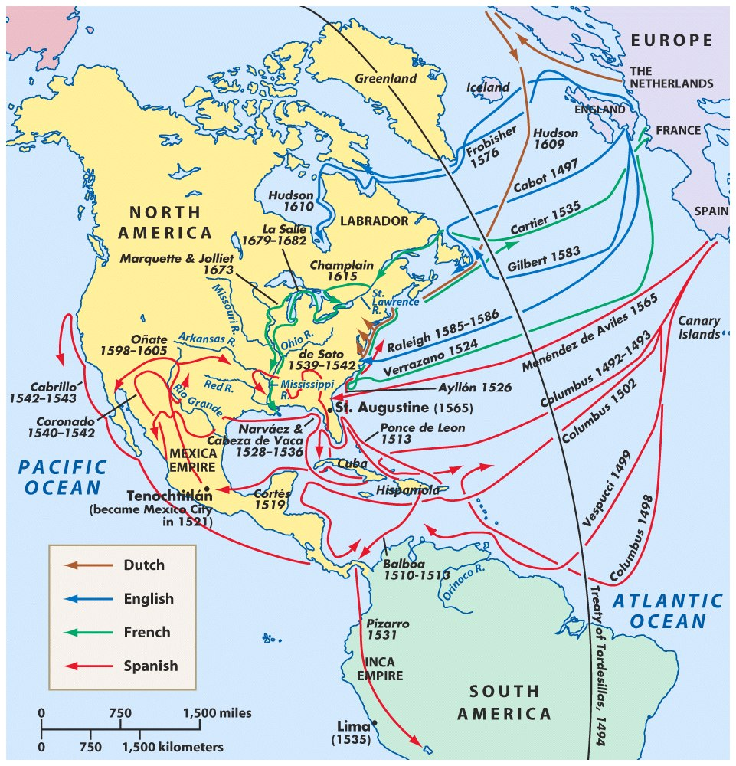
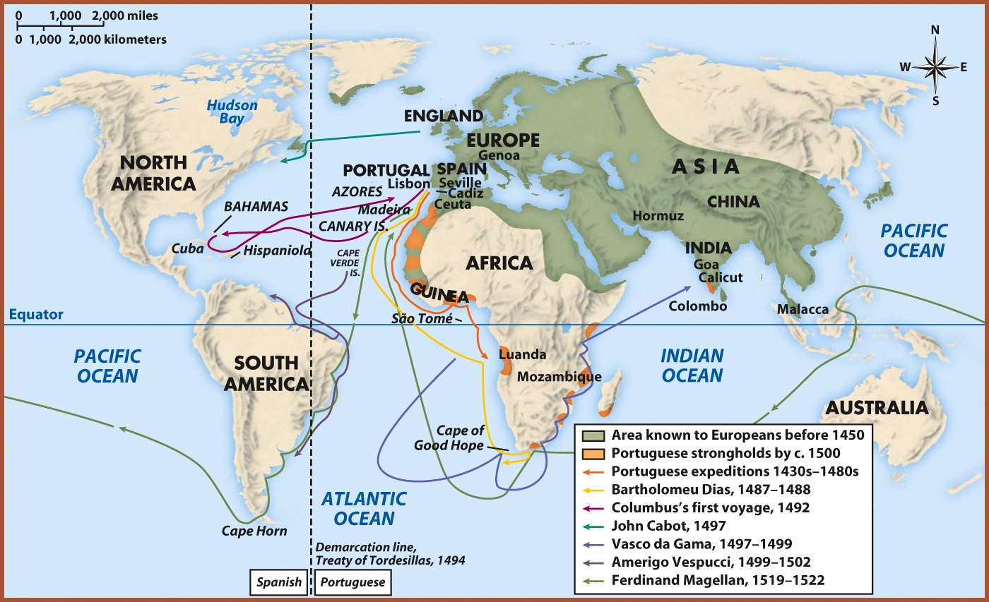
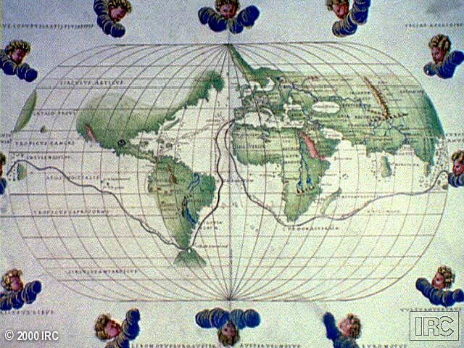
Ferdinand Magellan & the First Circumnavigation of the World

Slide 27
Explorers Sailing From Hispaniola
De Leon - colonist of Hispaniola - Established colony at Puerto Rico - Sailed north looking for Fountain of Youth - Discovered Florida - 1508
Balboa - colonist of Hispaniola - Established settlement in Panama - 1st European to see Pacific Ocean - 1513
de Coronado - Spain - Explored north from Mexico; up Colorado River; saw Grand Canyon -1540
de Soto - Spain - Explored Florida into Carolina’s and west to the Mississippi River - 1541

Slide 28
Explorers Sailing For Spain & Portugal
Vespucci - Italian sailing for both Spain and Portugal - Sailed to the America’s - Amerigo is his first name (where we get “America”) - 1501

Slide 29
Spanish Exploration
Columbus
Balboa
Cortes
Pizzaro
De Leon
De Soto
Coronado
Vespucci

Slide 30
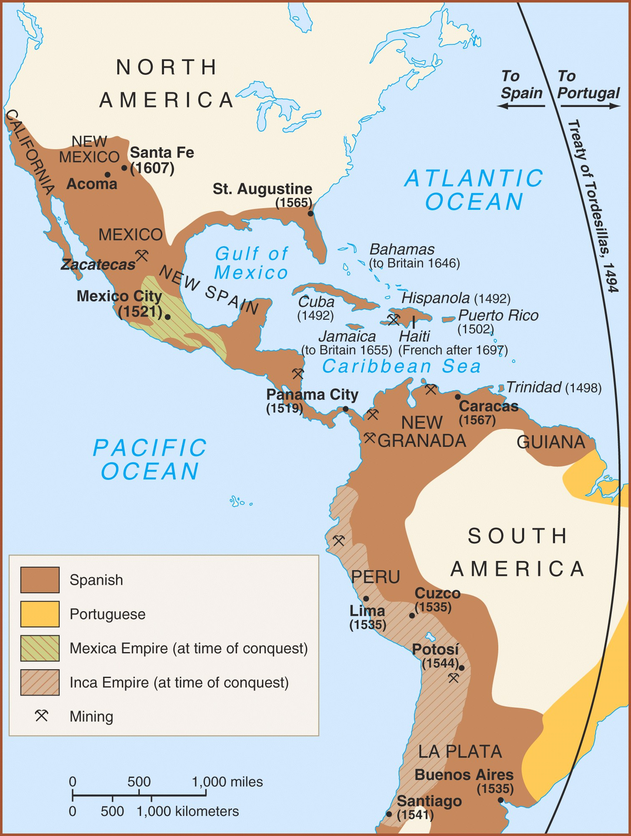
Spanish empire by the 1600’s consisted of the
part of North America
Central America
Caribbean Islands
Much of South America.

Slide 31
Spanish soldiers who came to the New World to help conquer and settle the Americas for Spain.
Some of their methods were harsh and brutal especially to the Native American population.
With every Spanish explorer were conquistadors and members of the Catholic Church to convert Native Americans.

Slide 32
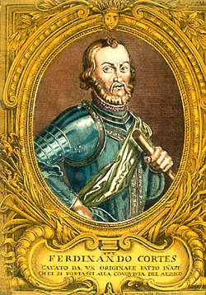
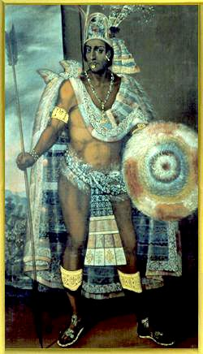
First Spanish Conquests: The Aztecs Cortes conquered Aztec Empire in 1519 and took control of modern day Mexico.
vs.
Hernando Cortés
Montezuma II

Slide 33
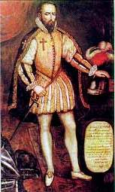
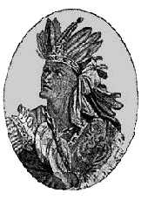
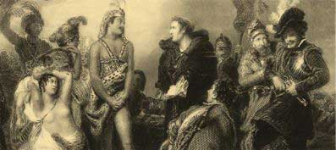
First Spanish Conquests: The Incas Pizarro conquered Incan Empire in modern day Peru in 1532
vs.
Francisco Pizarro
Atahualpa

Slide 34
Cycle of Conquest & Colonization
Explorers
Conquistadores
Missionaries
European Colonial Empire
Permanent Settlers

Slide 35
The Colonial Class System
Peninsulares Spanish ancestory
Creoles Spanish and Black mixture.
Mestizos Spanish and Indian mixture
Mulattos White American and Black mixture
Native Indians
Black Slaves

Slide 36
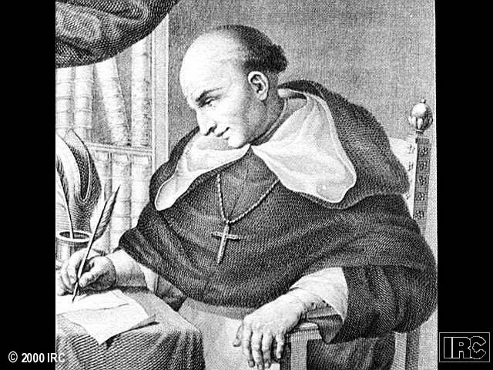
Father Bartolomé de Las Casas
Believed Native Americans had been treated harshly by the Spanish.
Indians could be educated and converted to Christianized.
Believed Indian culture was advanced as European but in different ways.
New Laws --> 1542

Slide 37
ENCOMIENDA SYSTEM
1. Spanish practice of securing an adequate and cheap labor supply = FEUDALISM
“granted” to deserving subjects of the King
2. Conquistador controlled Indian populations
Required Indians to pay tribute from their lands
Indians often rendered personal services as well.
3. In return the conquistador was obligated to
protect his wards
instruct them in the Christian faith
defend their right to use the to live off the land
4. Encomienda system eventually decimated Indian population.
5. The King prevented the encomienda with the New Laws (1542) supported by de Las Casas, the system gradually died out.

Slide 38
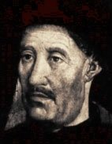
European Colonization
The Portuguese
The Portuguese were the first to begin searching for an all water route to Asia…..
Prince Henry the Navigator – 1450’s
Colonized the South America in the area of what would become Brazil

Slide 39
Explorers Sailing For Portugal
Prince Henry the Navigator - Portugal - Funded Exploration down coast of Africa - 1419-1460
Dias - Portugal - Rounded the Cape of Good Hope - 1488
da Gama - Portugal - Opened trade with India - Placed Portugal in position to dominate trade with India - 1498
Cabral - Portugal - Claimed present day Brazil for Portugal - 1500

Slide 40
European trade routes

Slide 41
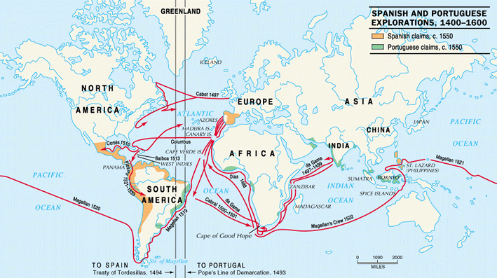
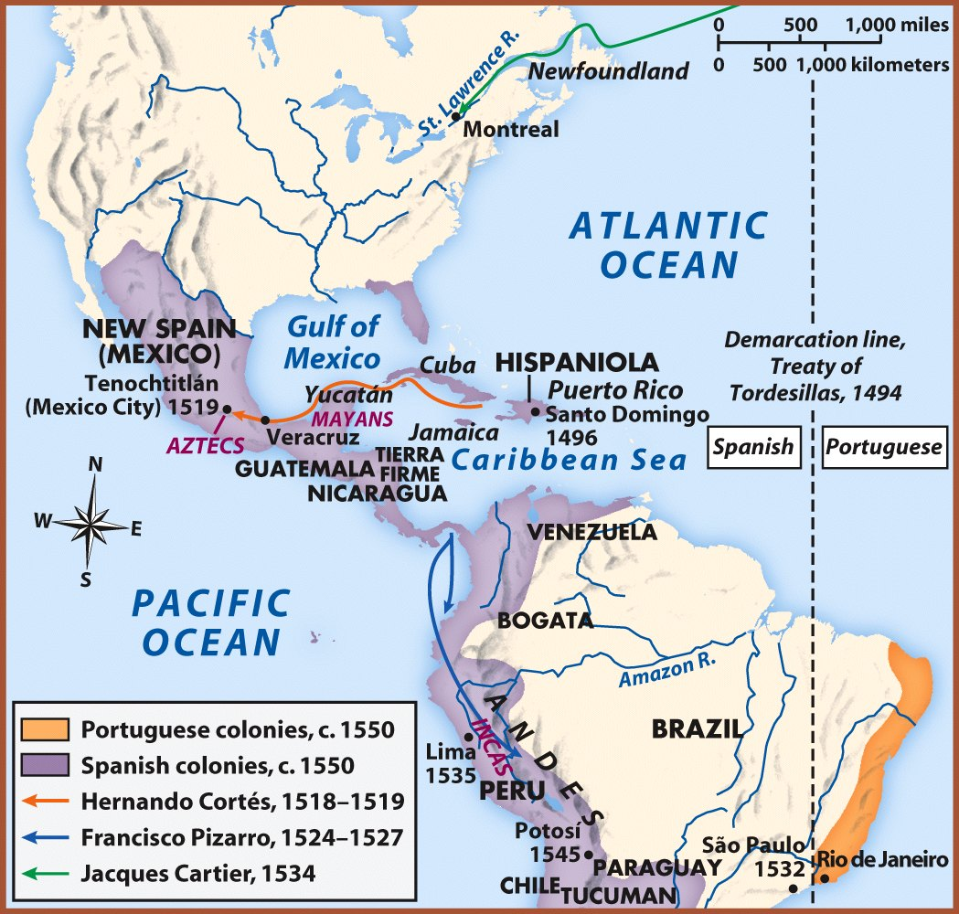
The Treaty of Tordesillas, 1434 & The Pope’s Line of Demarcation, 1493

Slide 42
The French
French settle Quebec (1608) & Montreal (1642) and what would become Canada
Control St. Lawrence River & access to interior of North America
Develop a fur trade
Couier do Bois

Slide 44
Explorers Sailing For France
Cartier - France - Reached St. Lawrence River - Claimed Eastern Canada for France – 1535
Samuel de Champlain - France - “Father of New France” - Established Quebec (the 1st permanent French colony in N. America) - Established settlements and explored Maine, Montreal & Nova Scotia - 1608

Slide 46
European Colonization
The Dutch
Like French, Dutch focus on fur trade & send only a few men to settlements
Found Albany (New York, 1614) on Hudson River
New Netherland (becomes New York) is an extension of the Dutch global trade system
Dutch & French form alliances with Native Americans—increase warfare & Iroquois (Dutch ally) defeat Hurons

Slide 47
Explorers Sailing For The Netherlands
Henry Hudson - English sailing for the Dutch - Searching for Northwest Passage - Claimed Hudson River - Settlers established New Netherlands (New York) - 1609

