Slide 1
Isolationism VS Interventionism: WWI and The Iraq War
APUSH
6/5/2016

Slide 2
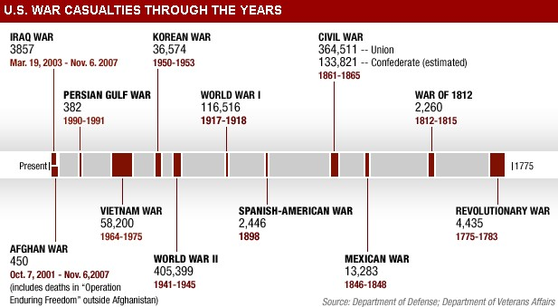
War Timeline
Revolutionary War
War of 1812
Mexican American War
Civil War
Spanish-American War
WWI
WWII
Korean War
Vietnam War
Persian Gulf War
Afghan War
Iraq War

Slide 3
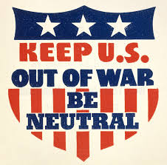
Isolationism
Isolationism was America’s view that European affairs should be dealt with by Europeans.
Before and during WWI, America was an Isolationist country.
Thomas Paine’s “Common Sense” contributed greatly to this view.
Common Sense provided many reasons why America should shun alliances.

Slide 4
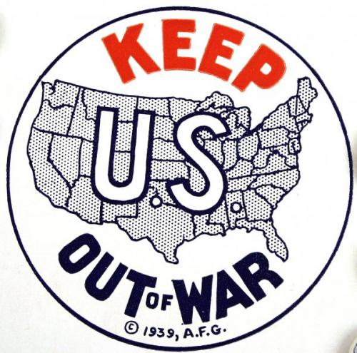
Social Isolationism
“Europe is Europe. America is America”
Ever since the Revolutionary War and the War of 1812, Americans held a vendetta against European countries.
Not only was the government very unwilling to help European countries, but many American citizens shared this view.
America’s seeming fear of foreigners only emphasised this separation.

Slide 5
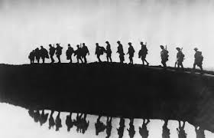
WWI
Escalated after the assassination of Austrian Archduke Franz Ferdinand.
The Central Powers:
Germany
Austria-Hungary
The Ottoman Empire
The Allied Powers:
Great Britain
France
Russia
Italy
Japan

Slide 6
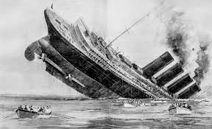
The Lusitania
The US public stayed opposed to joining the war until May 1915, when a German U-Boat sunk the British Lusitania, which was carrying many American passengers.
After the sinking of the Lusitania, the American public switched their opinion to one that was majorly anti-German.
On April 2 1917, President Woodrow Wilson called for a declaration of war on Germany.

Slide 7
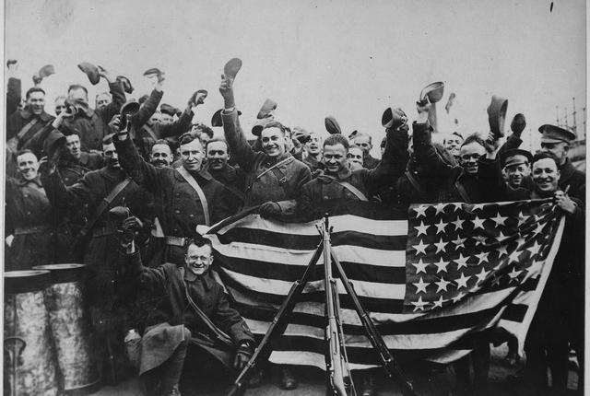
America In WWI
With America in the picture, the Allies became drastically stronger, and eventually started pushing back all the German fronts.
Eventually, Germany was forced to seek an armistice on November 11, 1918.
After WWI, the Treaty of Versailles was created, though congress failed to approve it.

Slide 8
The League of Nations
Though Woodrow Wilson pushed the creation of the League of Nations, congress did not approve America joining the league.
The American people believed that joining the League of Nations would simply drag the US into another European war.
This was a large sign of America's retreating back into isolationism.

Slide 9
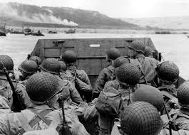
During WWII
For American involvement, WWII was very much a mirror of WWI.
Like WWI, when the war first began America remained strictly isolationist.
Like WWI, America did not enter the war until Americans were attacked, in this case, by the Japanese at Pearl Harbor.
However, unlike WWI, America had been subtly helping the Allies through “Neutrality Acts” throughout the war.
In the case of WWII, the Allies were Britain, France, USSR, Australia, Belgium, Brazil, Canada, China, Denmark, Greece, Netherlands, New Zealand, Norway, Poland, South Africa, Yugoslavia

Slide 10
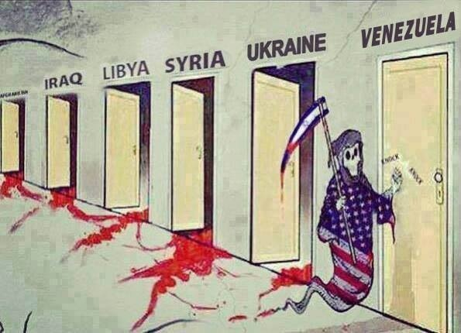
Interventionism
Interventionism is the direct opposite of isolationism.
Interventionism is the policy to intervene or attempt to influence events both reactively and preventively.
After WWII, the US practiced containment to attempt to stop the spread of communism.

Slide 11
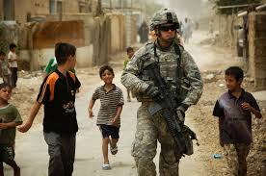
The Iraq War
Iraq was led by dictator Saddam Hussein
There were 6 main reasons for the US entering war with Iraq.
9/11 and the 1991 Gulf War
Afghanistan
Majority Support
Possibility of WMDs
Rebuilding
Oil

Slide 12
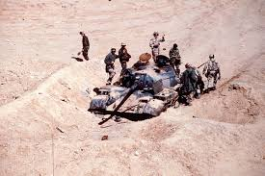
The Gulf War
1990-91:
In August, Saddam Hussein orders the invasion of Iraq's neighbour, Kuwait.
Saudi Arabia and Egypt urge the United States to intervene.
The United Nations requests Hussein to withdraw from Kuwait, Hussein refuses.
The Persian Gulf War begins with a massive air strike, called Operation Desert Storm.
Eventually the Iraqis retreated, though Hussein remained in power.

Slide 13
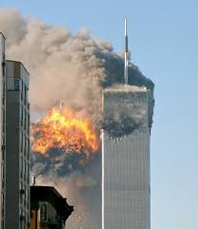
9/11
September 11, 2001:
Two planes crash into both towers of the World Trade Center in New York.
It is later discovered that these planes were hijacked by terrorists associated with al-Qaeda.
A third plane crashes into the pentagon in Washington D.C.
Over 3,000 people killed.

Slide 14
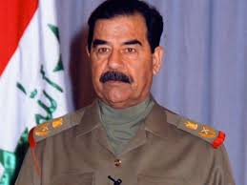
Saddam Hussein
Saddam Hussein had faced off against the US during the Gulf War.
Under his command, Iraq helped terrorist organizations, including al-Qaeda by provided headquarters, bases, training camps, and by selling weapons to them.
Hussein helped secular terrorist organizations that would target his enemies, in the case of al-Qaeda, Americans.

Slide 15
Compared To WWI
The significance in comparing the Iraq War to WWI is in America’s response to a problem.
Both problems were in a continent separated from America.
Both problems had the possibility to affect Americans, but not a certainty.
With WWI, America practiced an isolationist policy.
With Iraq, America practiced a preventative interventionist policy.
This is due to a change is both government and public opinion on America’s place in the world after WWII.

Slide 16
Works Cited
http://www.history.com/topics/world-war-i/world-war-i-history
https://www.apstudynotes.org/us-history/sample-essays/american-foreign-policy-isolationism-to/
http://www.history.com/topics/persian-gulf-war
http://www.u-s-history.com/pages/h1601.html
http://www.nationalreview.com/article/343870/why-did-we-invade-iraq-victor-davis-hanson
http://www.history.com/topics/9-11-attacks

